Slide 1
Planning Maintenance Work for Safer Roads and Work Environment
2021 Road Supervisors Training
January 26, 2021
Prattville Marriott Conference Center
Dennis McCall, P.E.
Butler County Engineer

Slide 2
Outline
Maintenance Duties
Roads
Bridges
Examples
1: Side-Drain Replacement
2: Scour at the Inlet of Cross-Drain
3: Scour at Side-Drain
4: Cross-Drain and Ditches Silted In
5: New Side-Drain Installation
6: Cross-Drain Needs Armor
Observations and Investigation
Needs
Equipment
Personnel
Materials
Questions / Comments

Slide 3
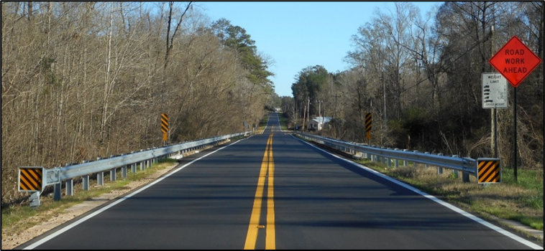
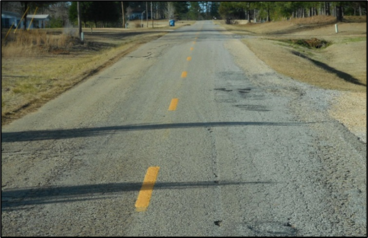
Maintenance Duties -Roads
Paved System
Leveling/Patching
Paving
Striping
Mowing
Ditching/Drainage
Shoulder Maintenance
Signage
Gravel System
Blading
Ditching / Drainage
Signage

Slide 4
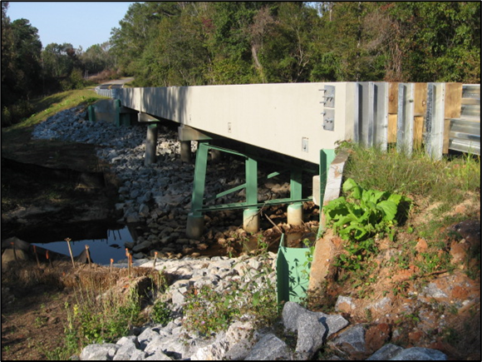
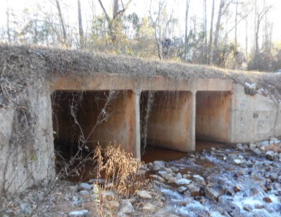
Maintenance Duties -Bridges
Bridges
Deck Maintenance
Painting
Armoring
Signage
Culverts
Armoring
Signage

Slide 5
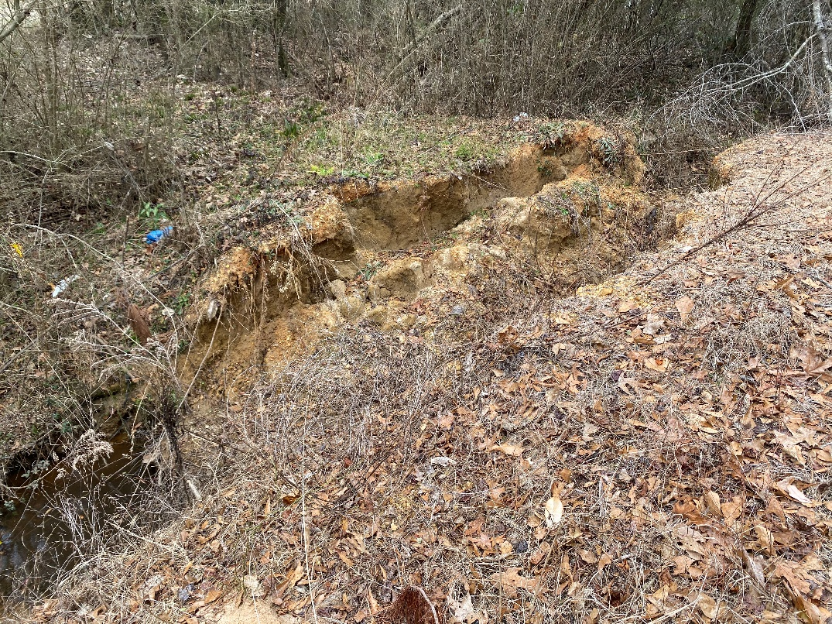
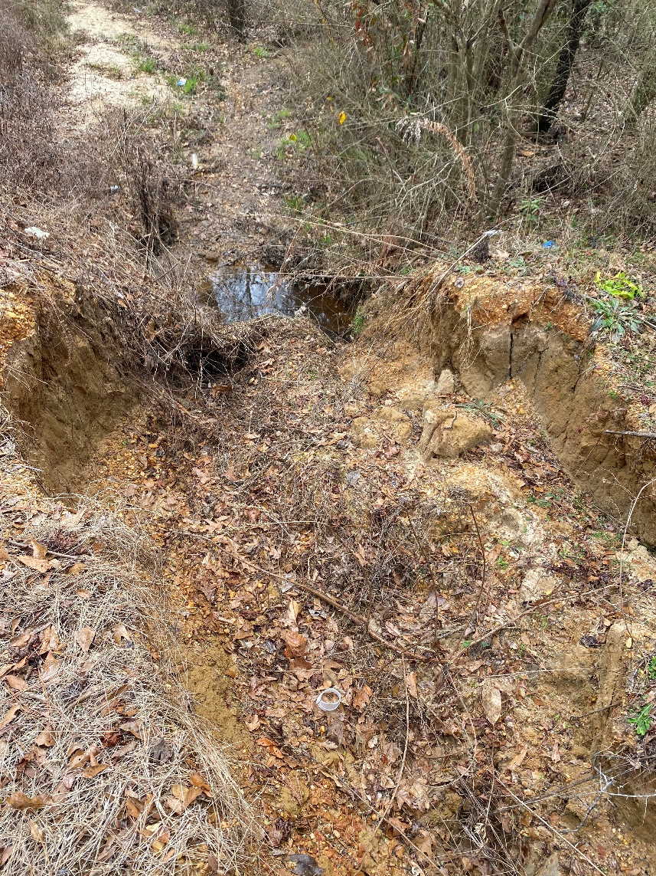
Example 1-Side Drain Replacement
The original call/ complaint was to replace a failed side-drain

Slide 7
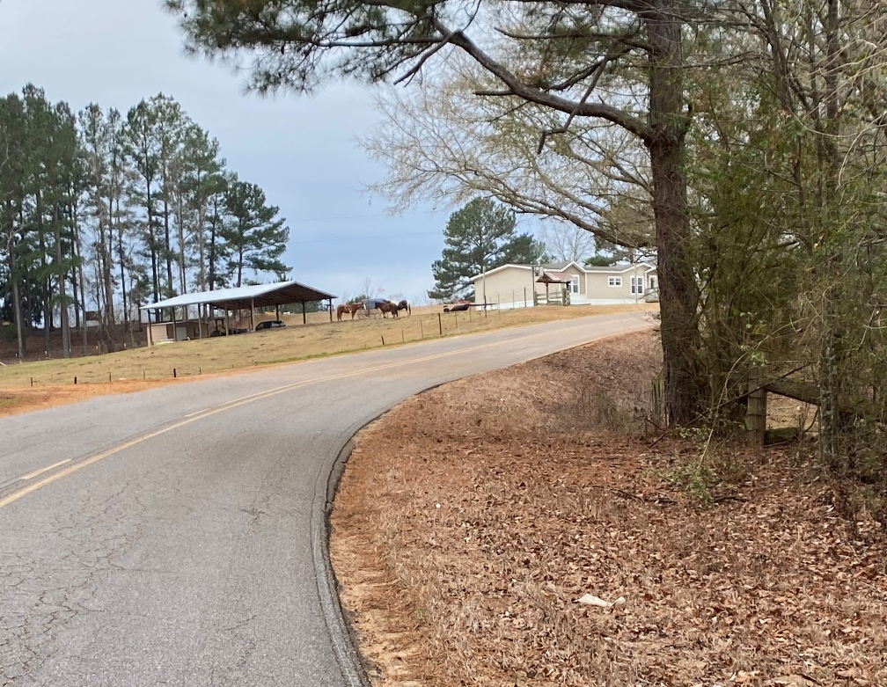
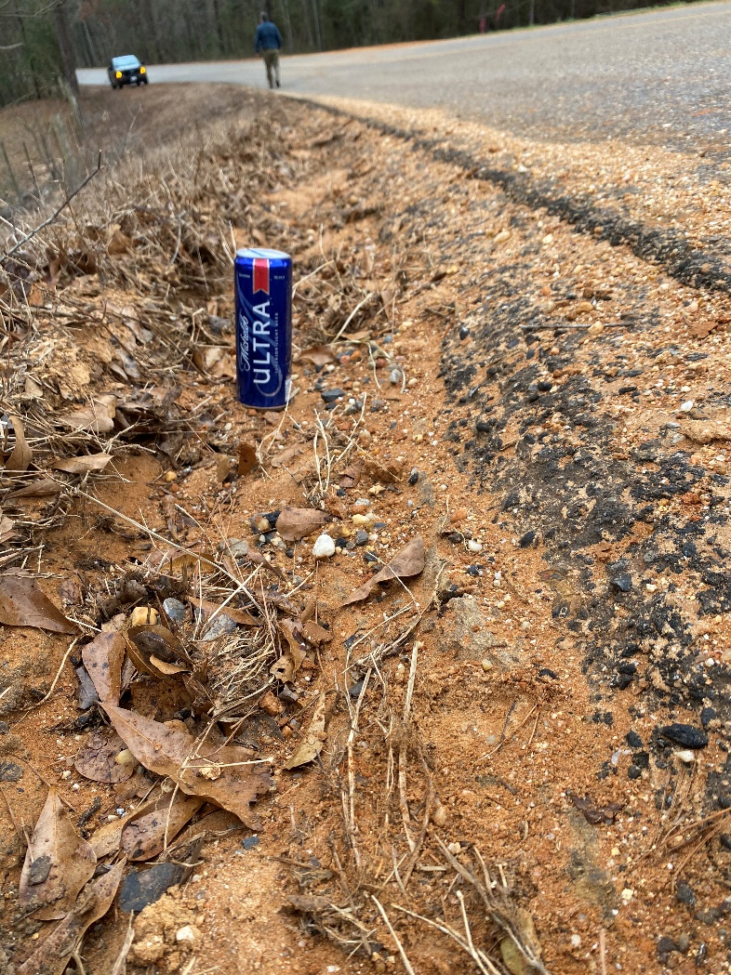
Example 1-Side Drain Replacement
Immediately uphill is a dangerous low shoulder

Slide 9
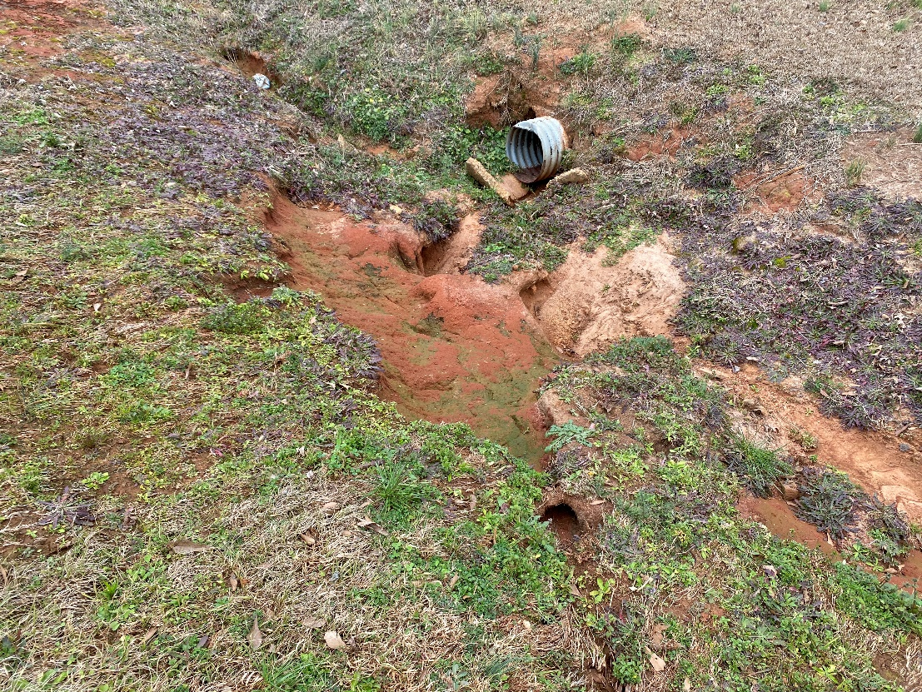
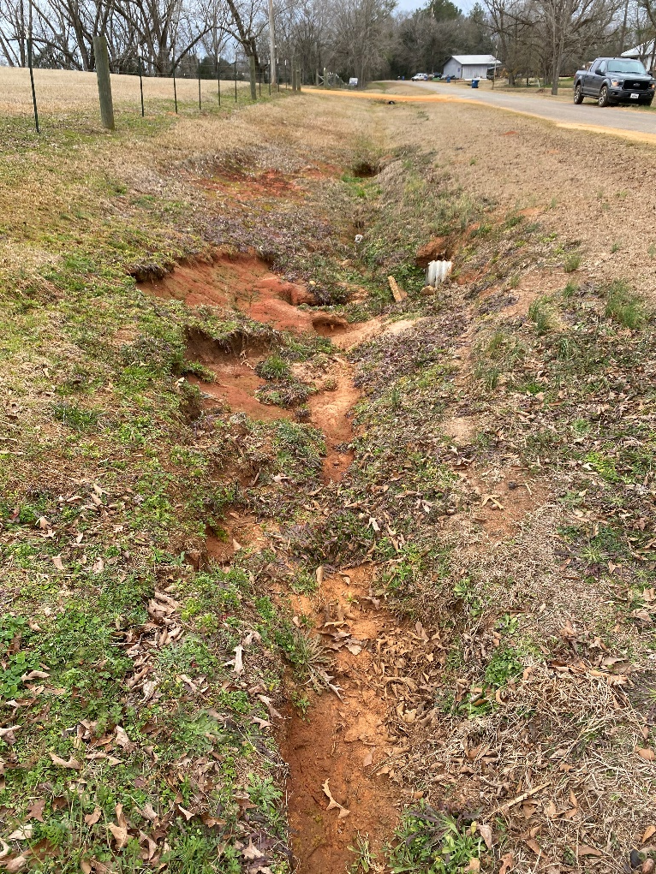
Example 2-Scour at the Inlet of Cross-Drain
Increased Runoff from Chicken Houses resulting in scour and erosion

Slide 11
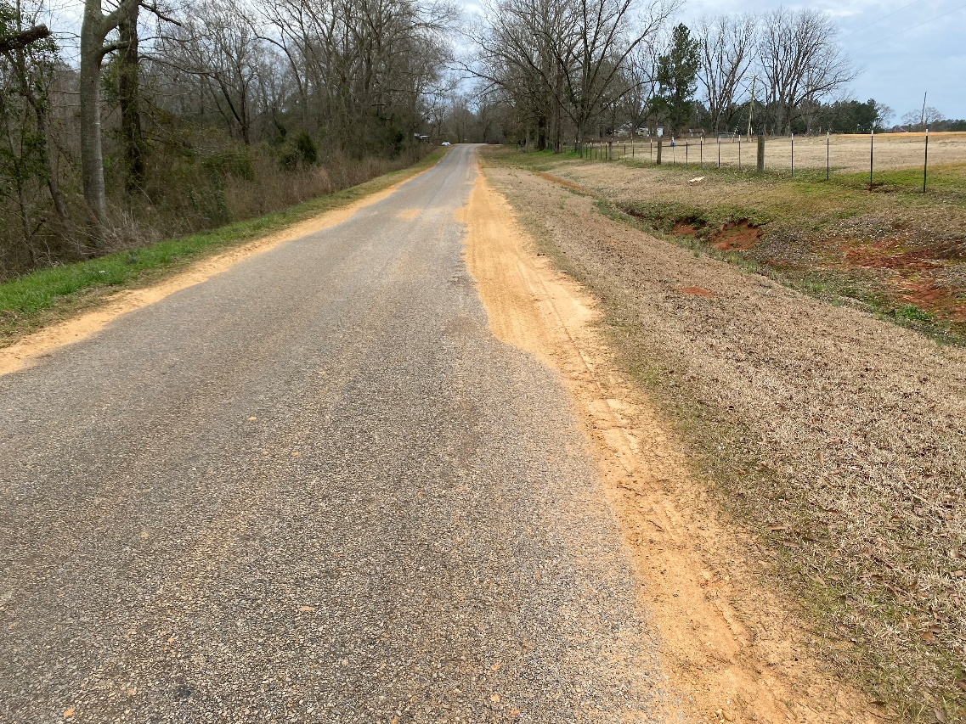
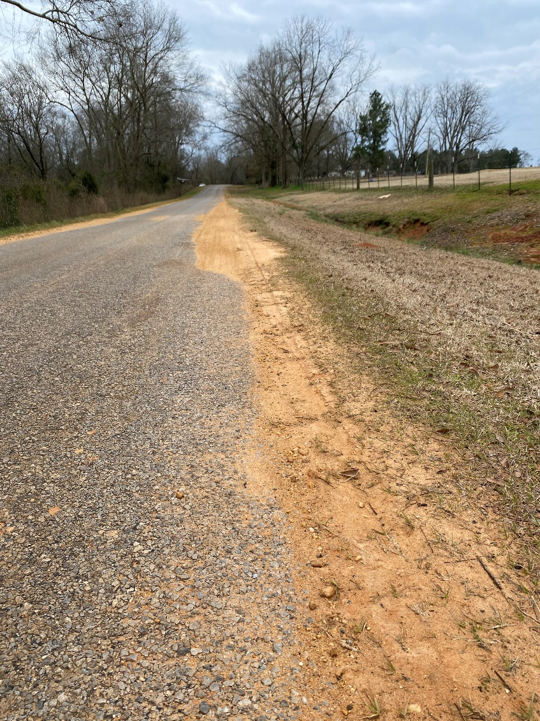
Example 2-Scour at the Inlet of Cross-Drain
High Shoulder also present creating Standing Water

Slide 12
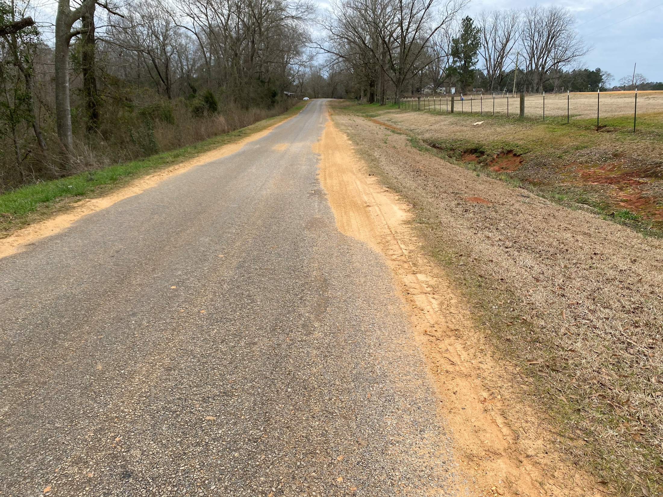

Slide 13
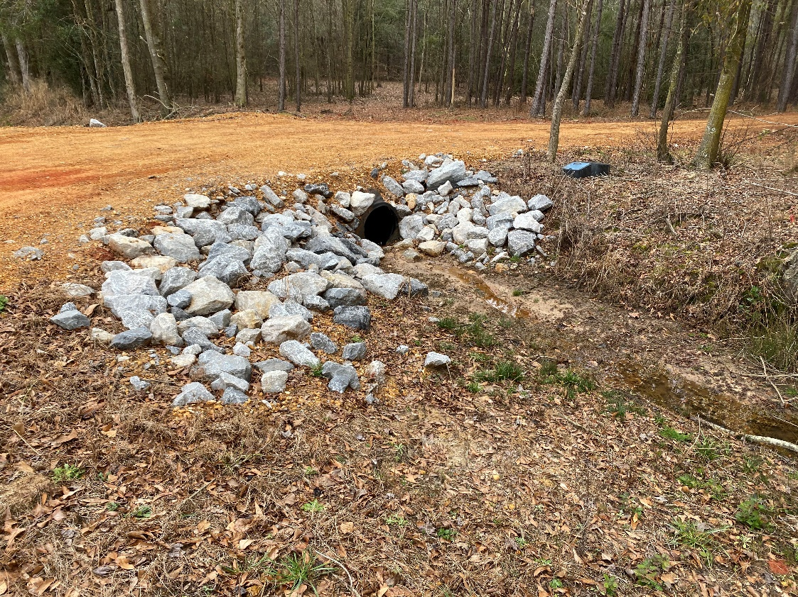
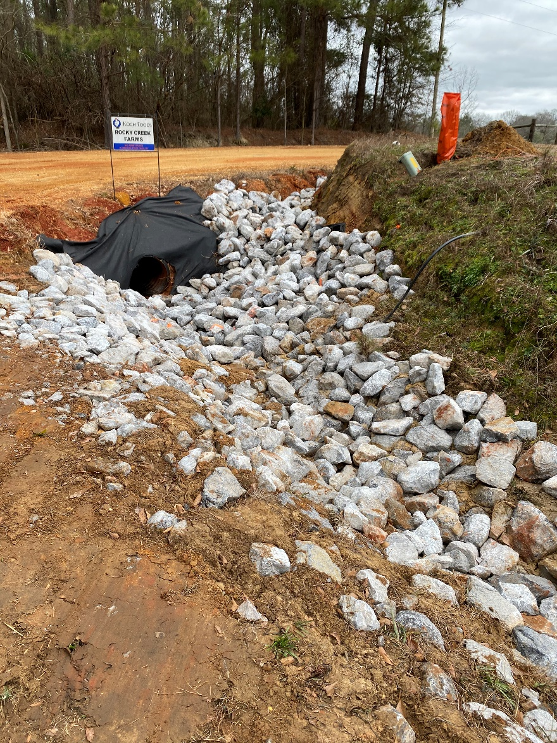
Example 3-Scour at Side-Drain
Increased Runoff from Chicken Houses resulting in scour and erosion at Side-Drain

Slide 14
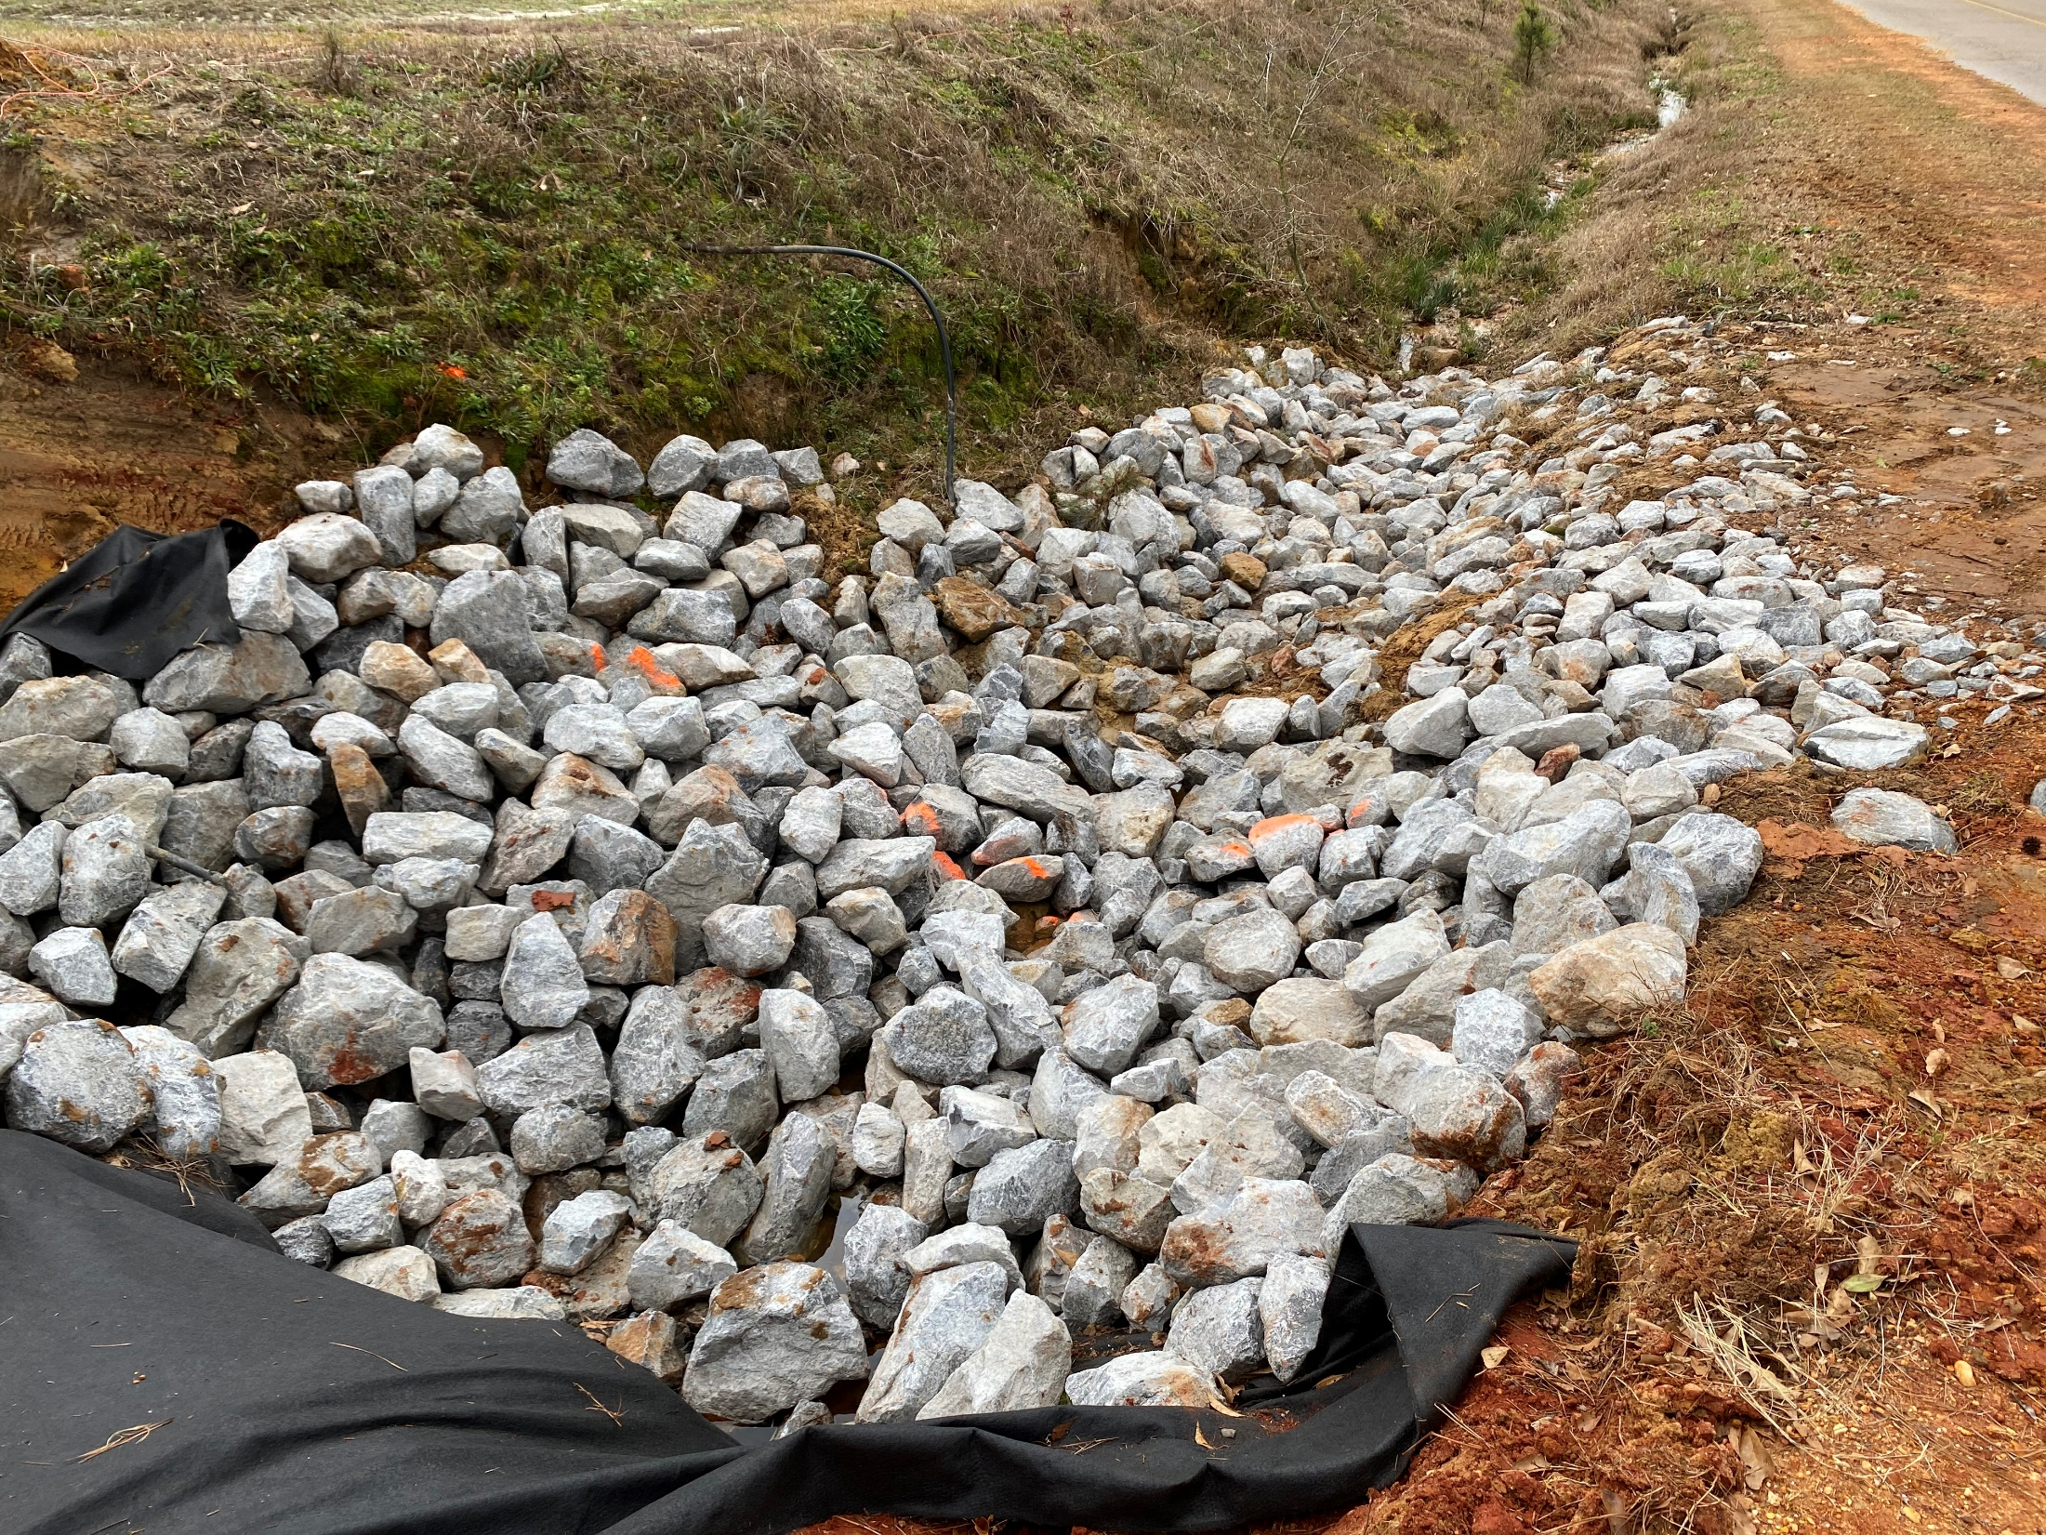

Slide 15
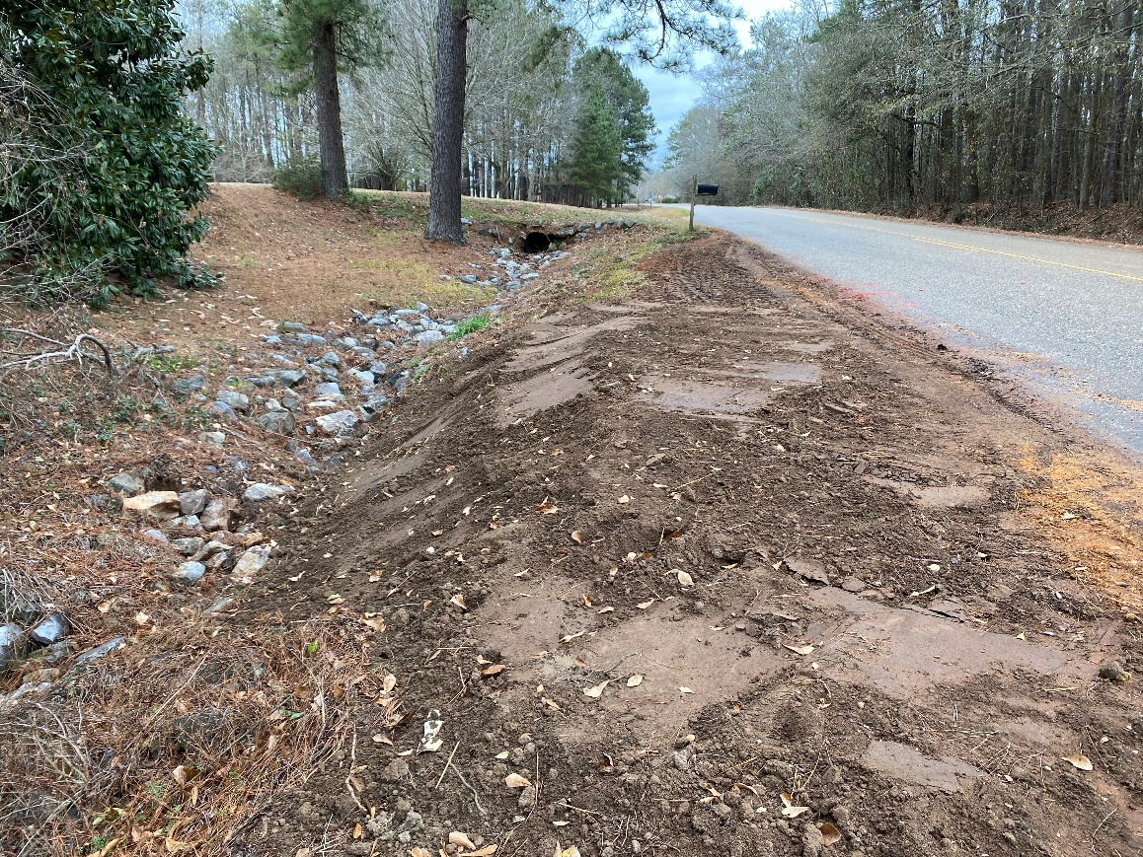
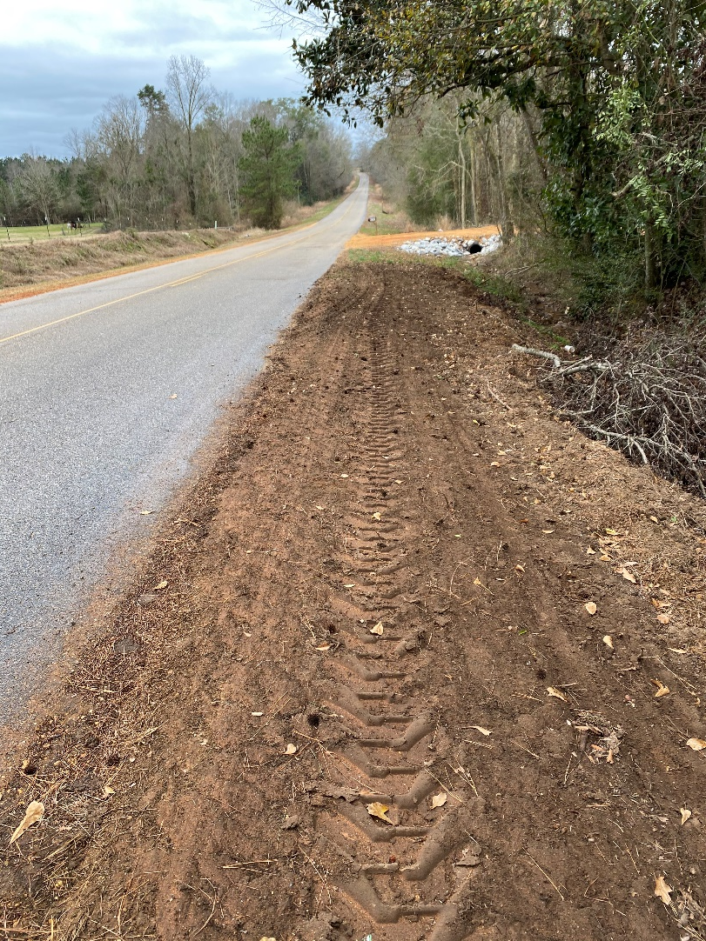
Example 3-Scour at Side-Drain
Adjacent Shoulder and Side-Drains also Affected

Slide 17
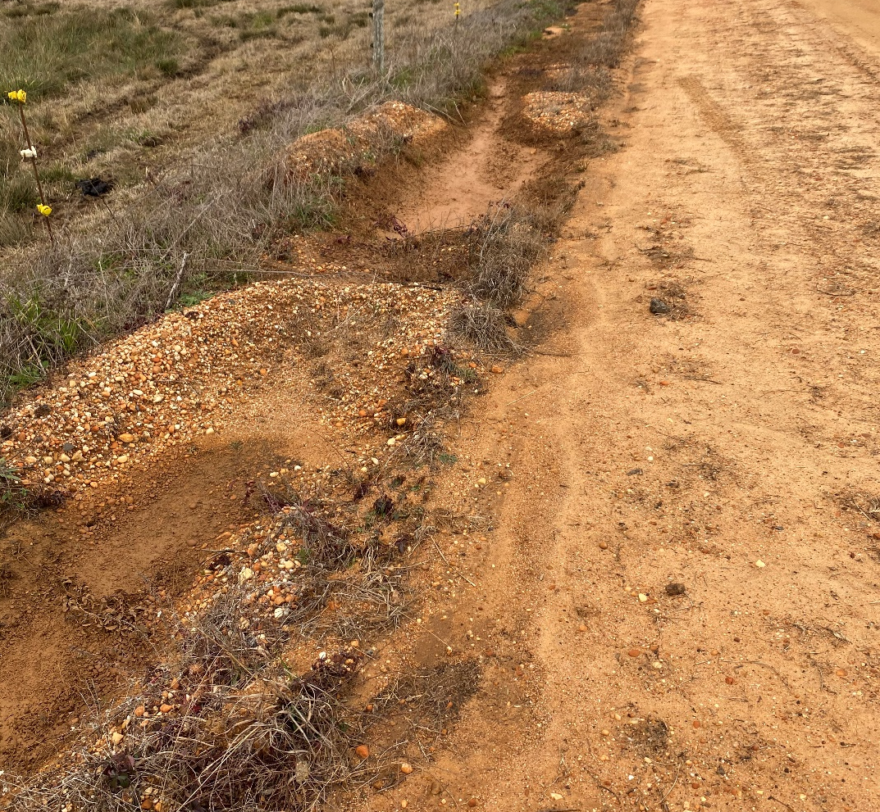
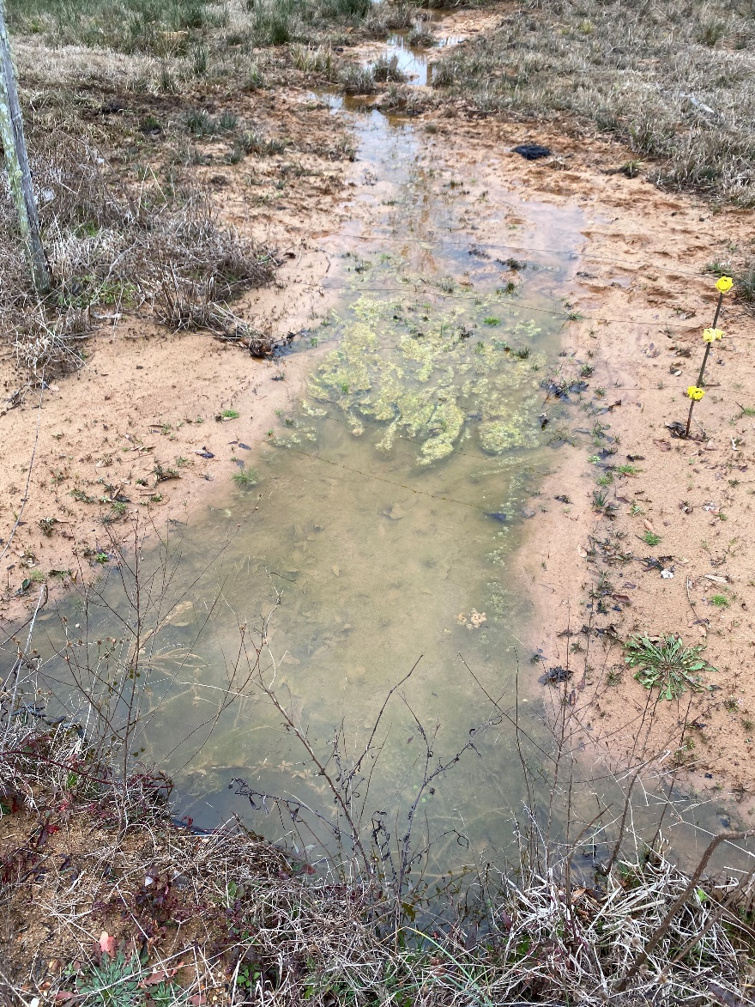
Example 4-Cross-Drain and Ditches Silted In
Drains to Pond and periodically Silts in

Slide 19
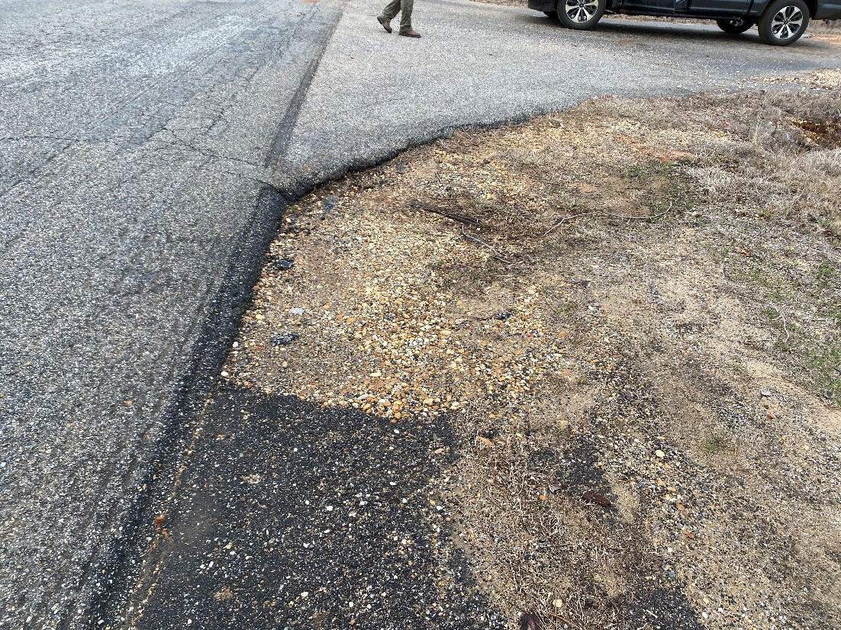
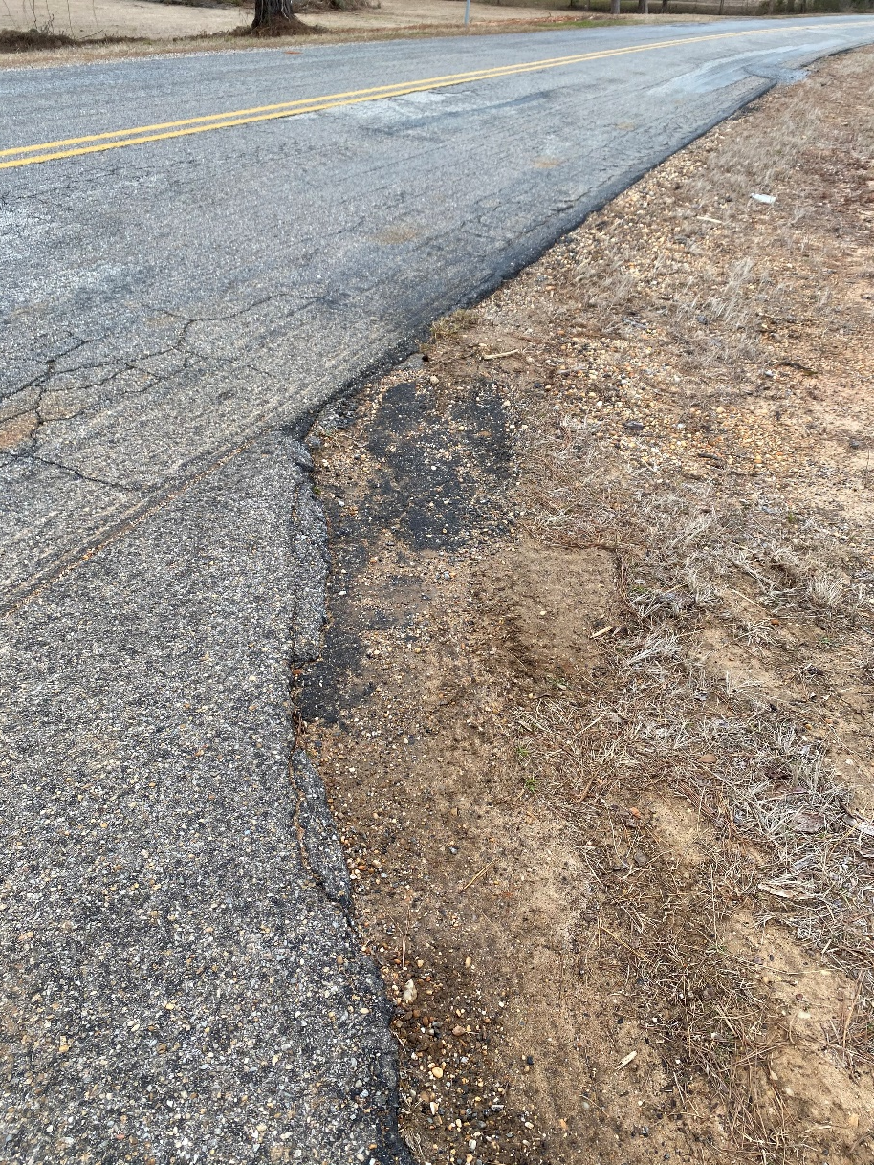
Example 4-Cross-Drain and Ditches Silted In
Local Shoulder at Intersection Nearby

Slide 20
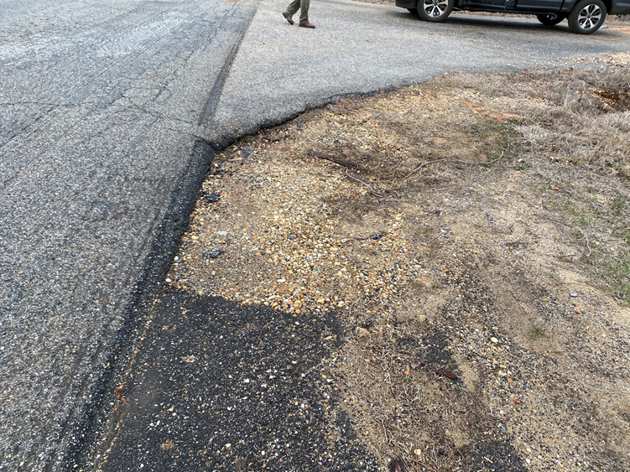

Slide 21
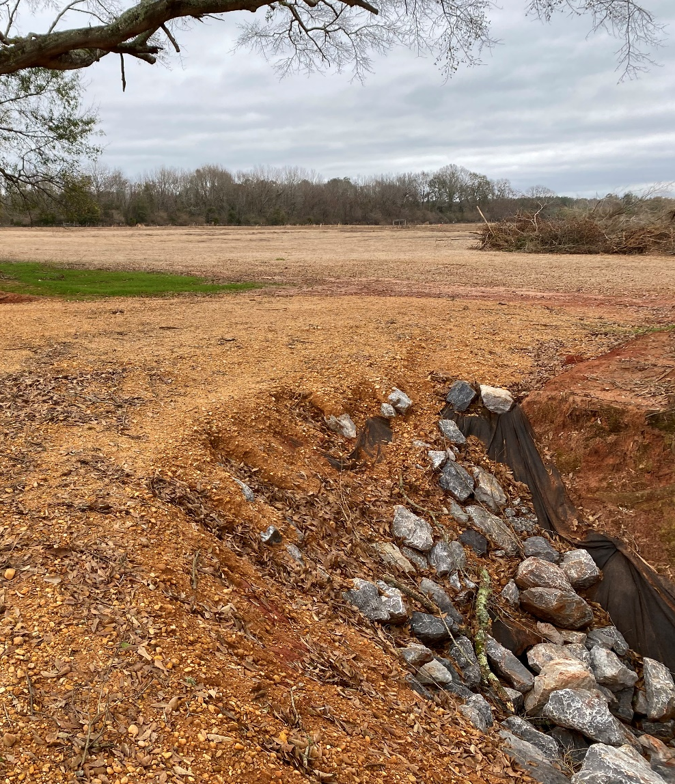
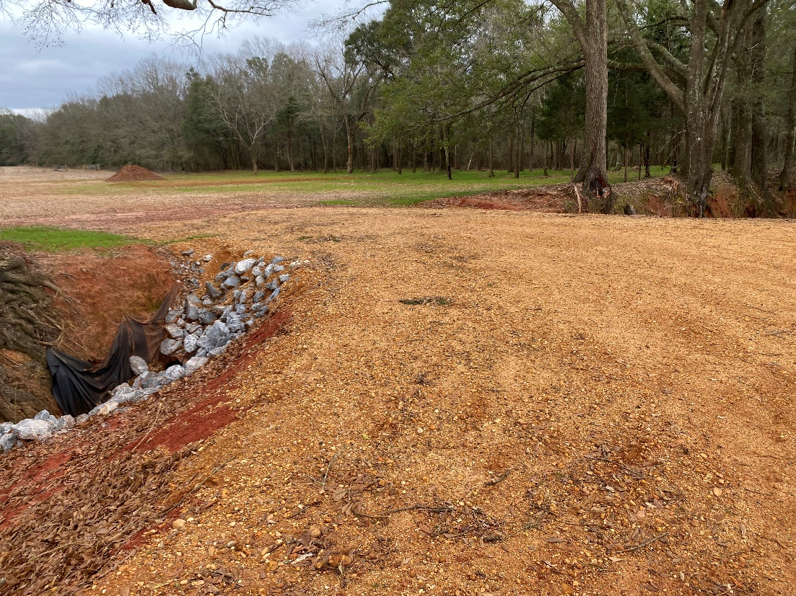
Example 5-New Side-Drain Installation
New Driveway Installed

Slide 23
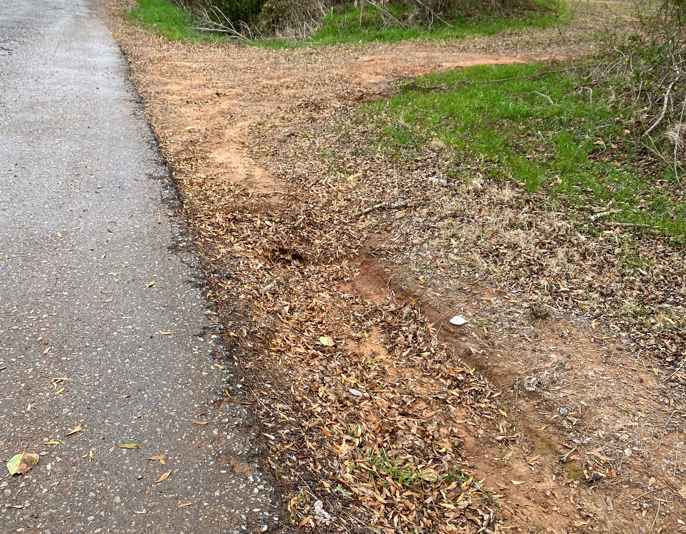
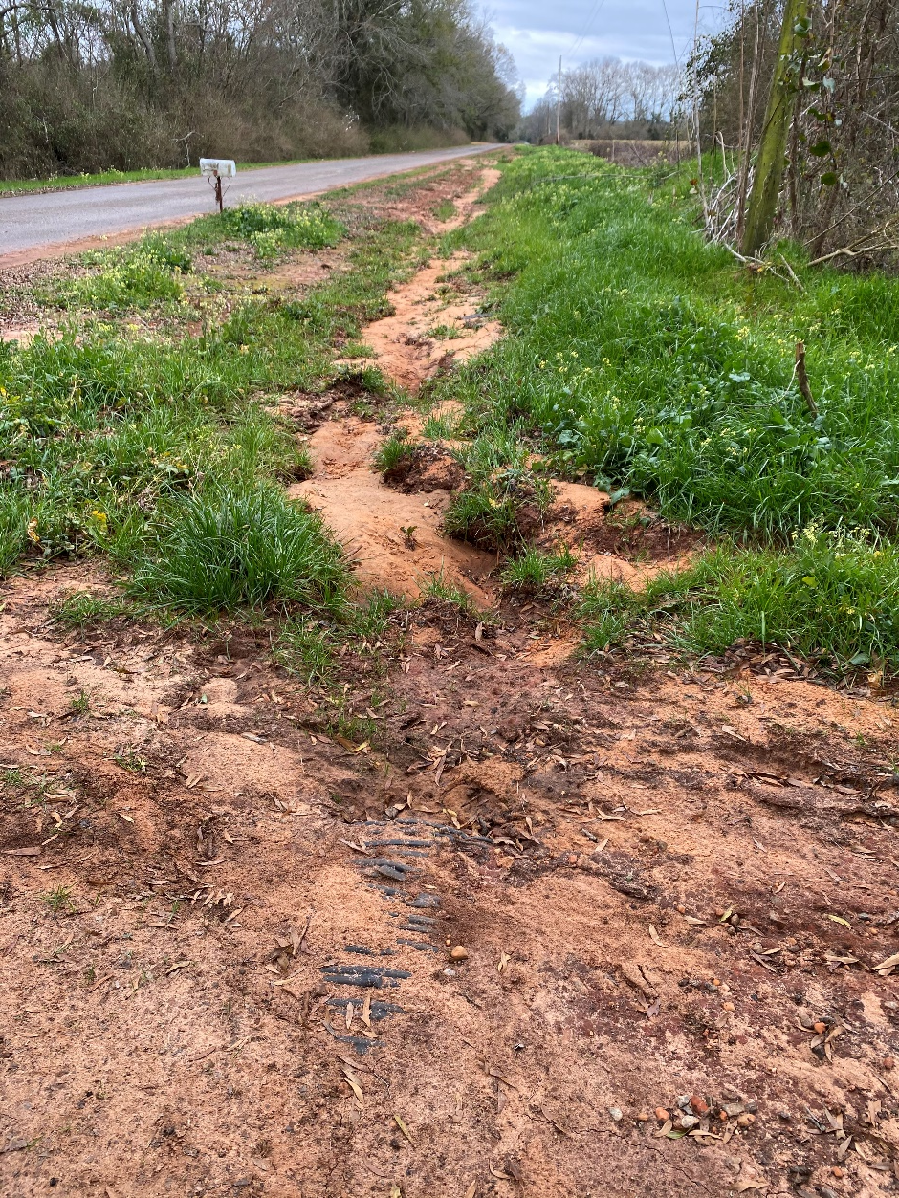
Example 5-New Side-Drain Installation
Side-Drain Maintenance Needed at 3 nearby Addresses

Slide 25
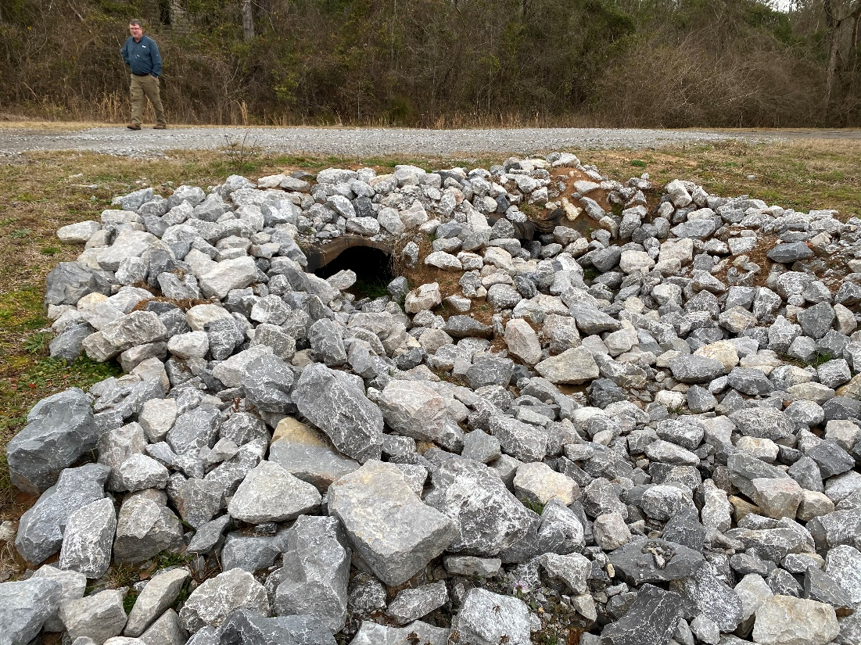
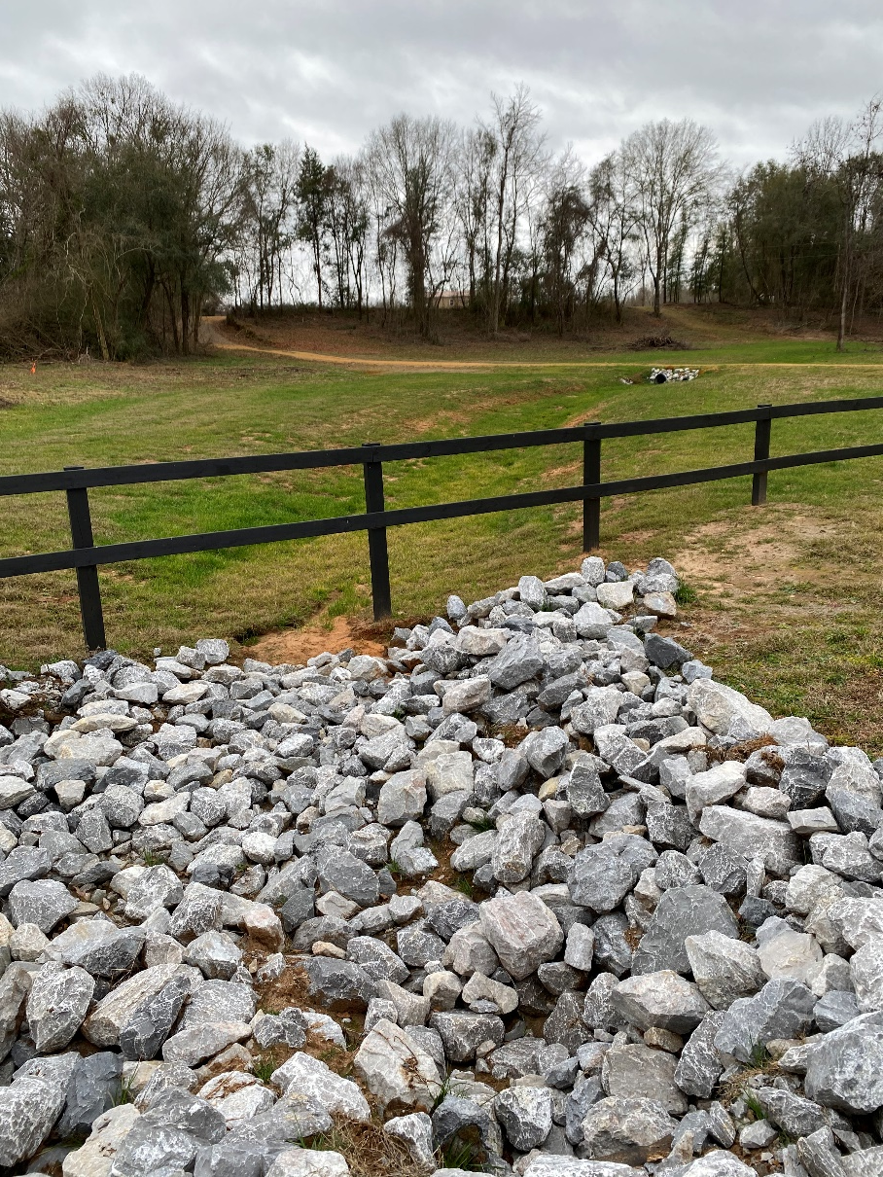
Example 6-Cross-Drains Need Armor
A double-Line of 36” CMP needs Armor, Erosion spreading off ROW

Slide 26
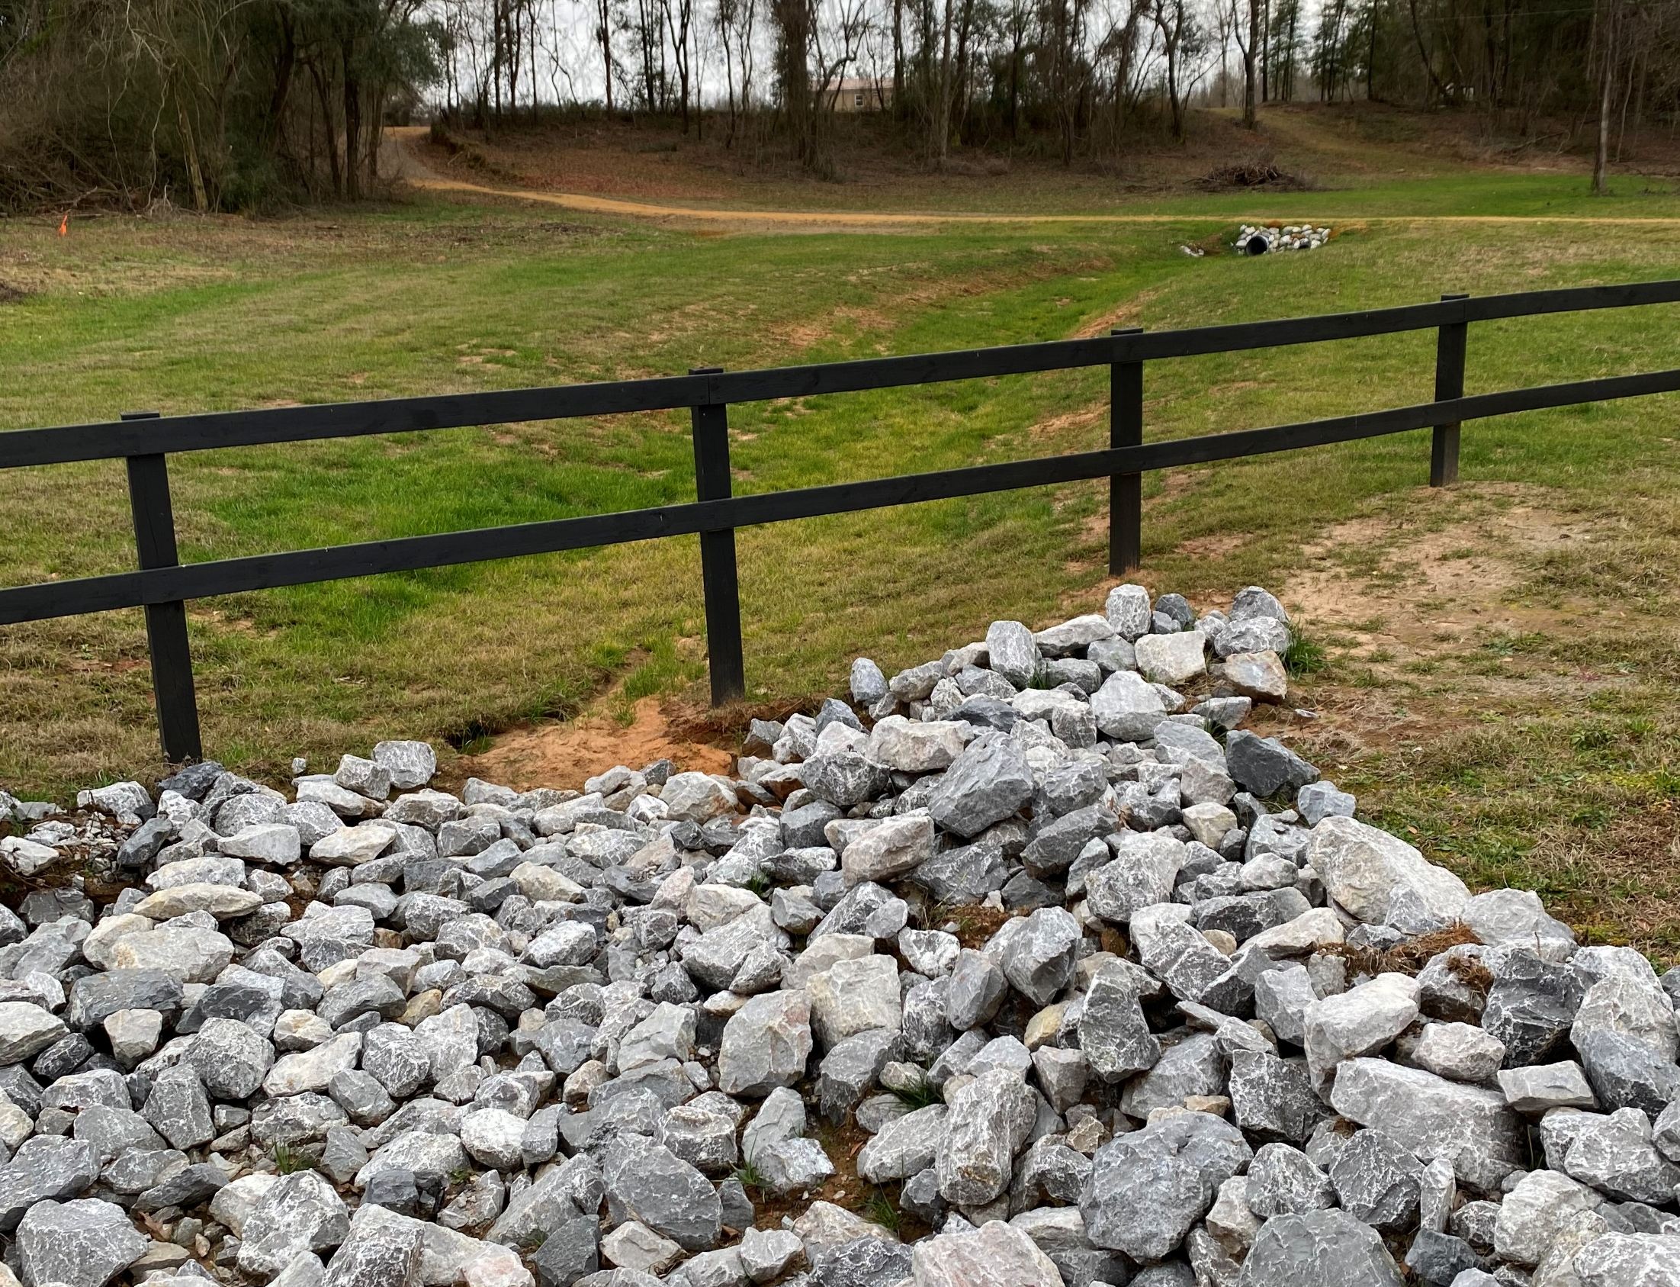

Slide 27
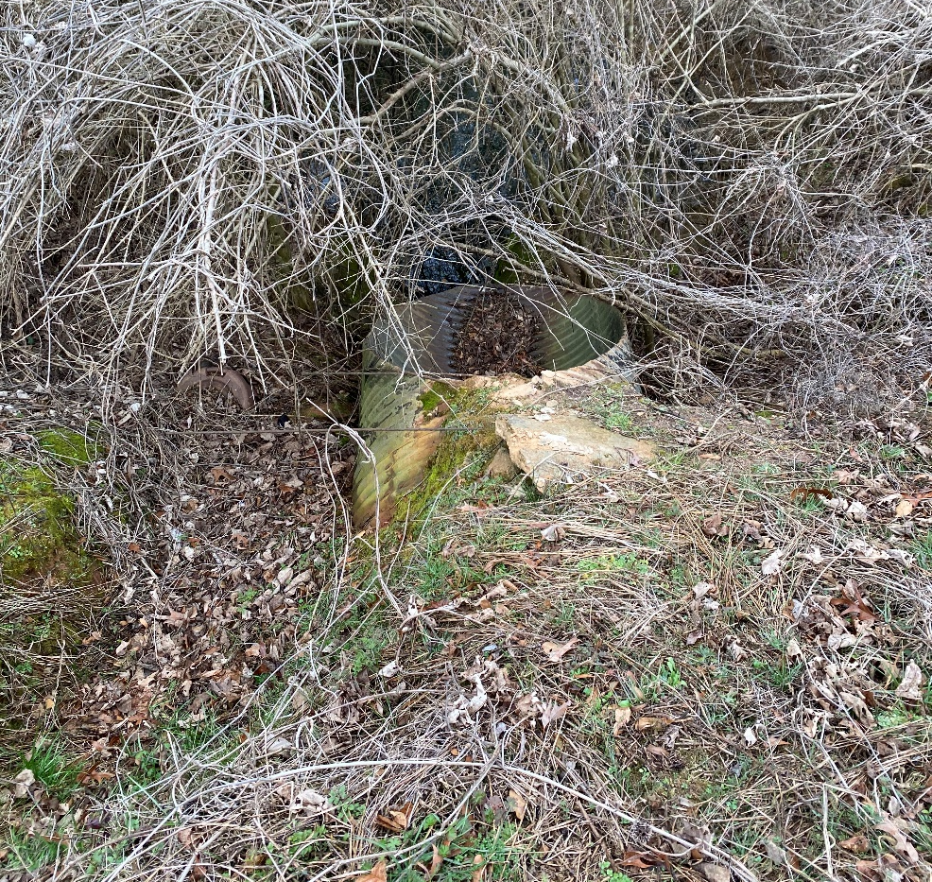
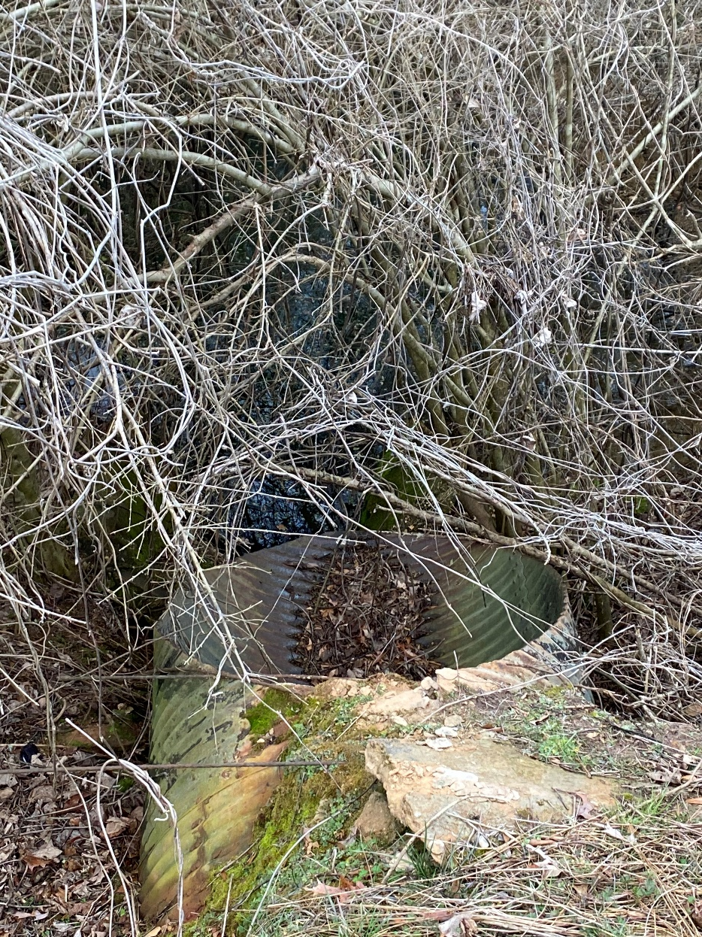
Example 6-Cross-Drains Need Armor
Large Cross-Drain Nearby needs Armor and Grading

Slide 28
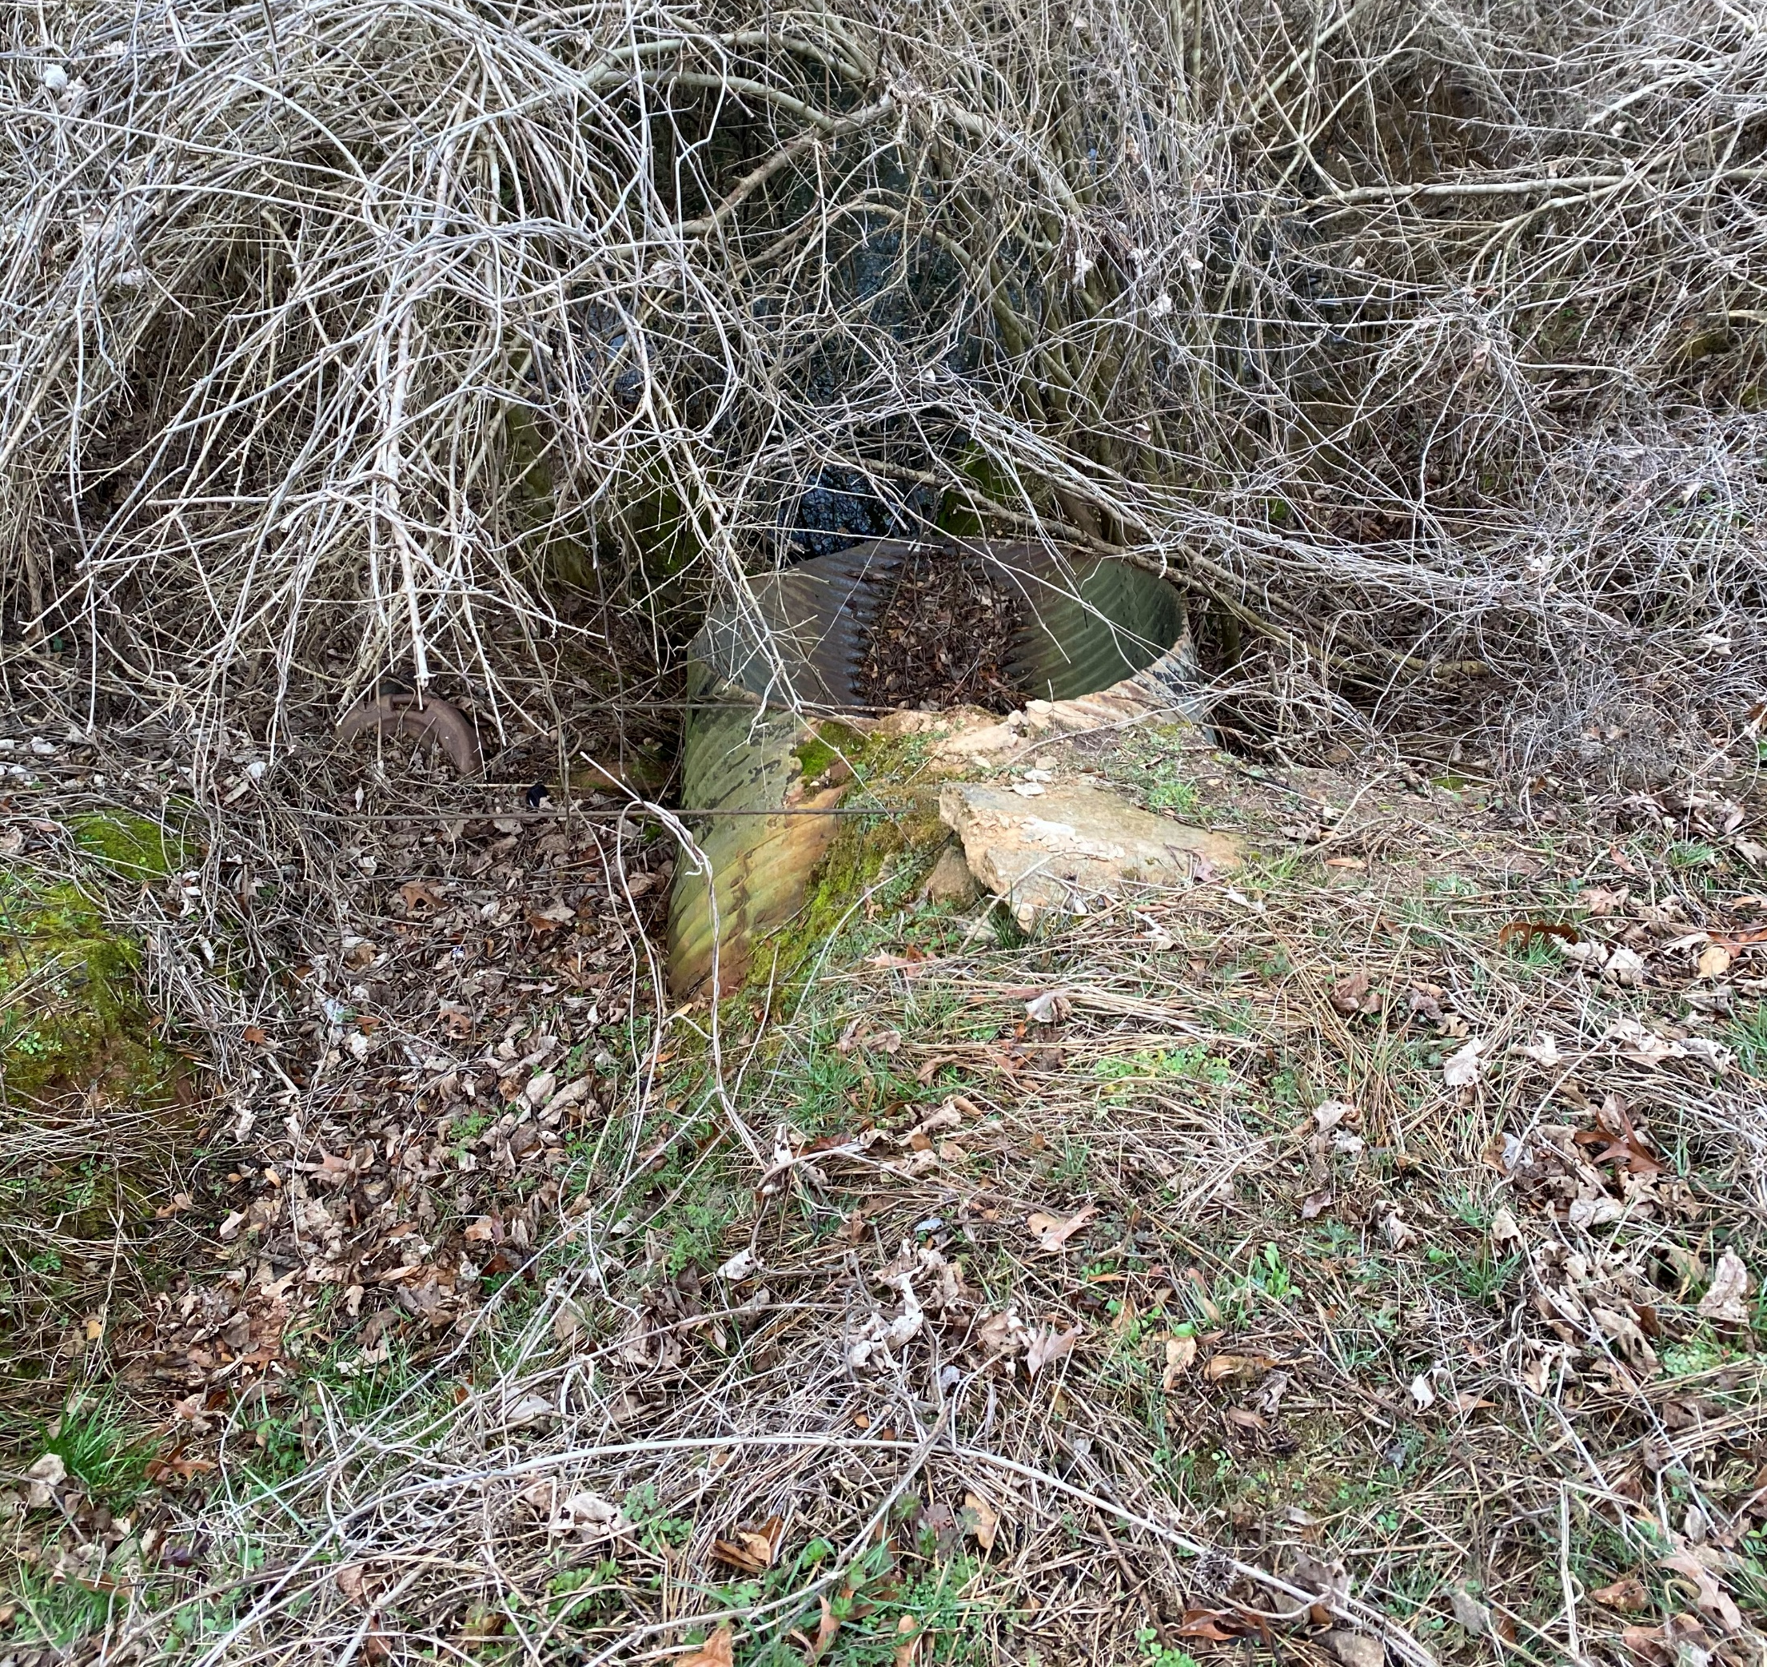

Slide 29
Observations and Investigation
Drainage Issue
Look at Least at the Immediate Drainage Area
Hilltop to Hilltop
Upstream and Downstream
Pothole Issue
Entire Route
Local Dead-End Routes
Shoulder Issue
Entire Route
Follow the traffic
Signage Issue
Entire Intersection
Entire Route

Slide 30
Needs-Equipment / Personnel /Materials
What crew will be assigned?
Should Another be assigned?
Can We Add Personnel?
Can We Add Equipment?
Will Different Materials be Needed?
Can You Use Locally Generated Material?
Will Additional Trucking be Needed?
Local Dead-End Routes

Slide 31
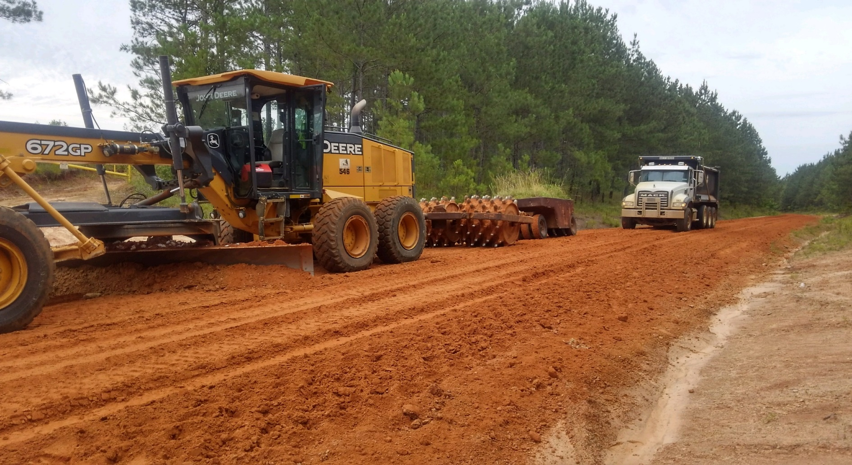
Questions / Comments?

