Slide 1
2021 Road Supervisors Training
January 26, 2021

Slide 2
Rainy Day Work
Rodney McCain
Assistant County Engineer
Calhoun County

Slide 3
Rainy Day Work
Scouting Issues in need of repair
Bridge Maintenance
Housekeeping Items

Slide 4
Rainy Day Work
Scouting issues in need of repair
High/low shoulders
Clogged drainage structures
Rutting
Any standing water that is a safety or structural concern
Potholes

Slide 5
Rainy Day Work
Bridge Maintenance
clearing vegetation
cleaning gutter line
cleaning abutment/bent cap of debris

Slide 6
Rainy Day Work
Housekeeping Items
Equipment Preventative Maintenance
Inventory
Planning for upcoming work
Training

Slide 7
Rainy Day Work
Scouting
High Shoulders – can cause water to stand on the roadway creating a safety concern
Also can create structural issues
Low Shoulders- Safety Concern
Sign of other potential issue

Slide 8
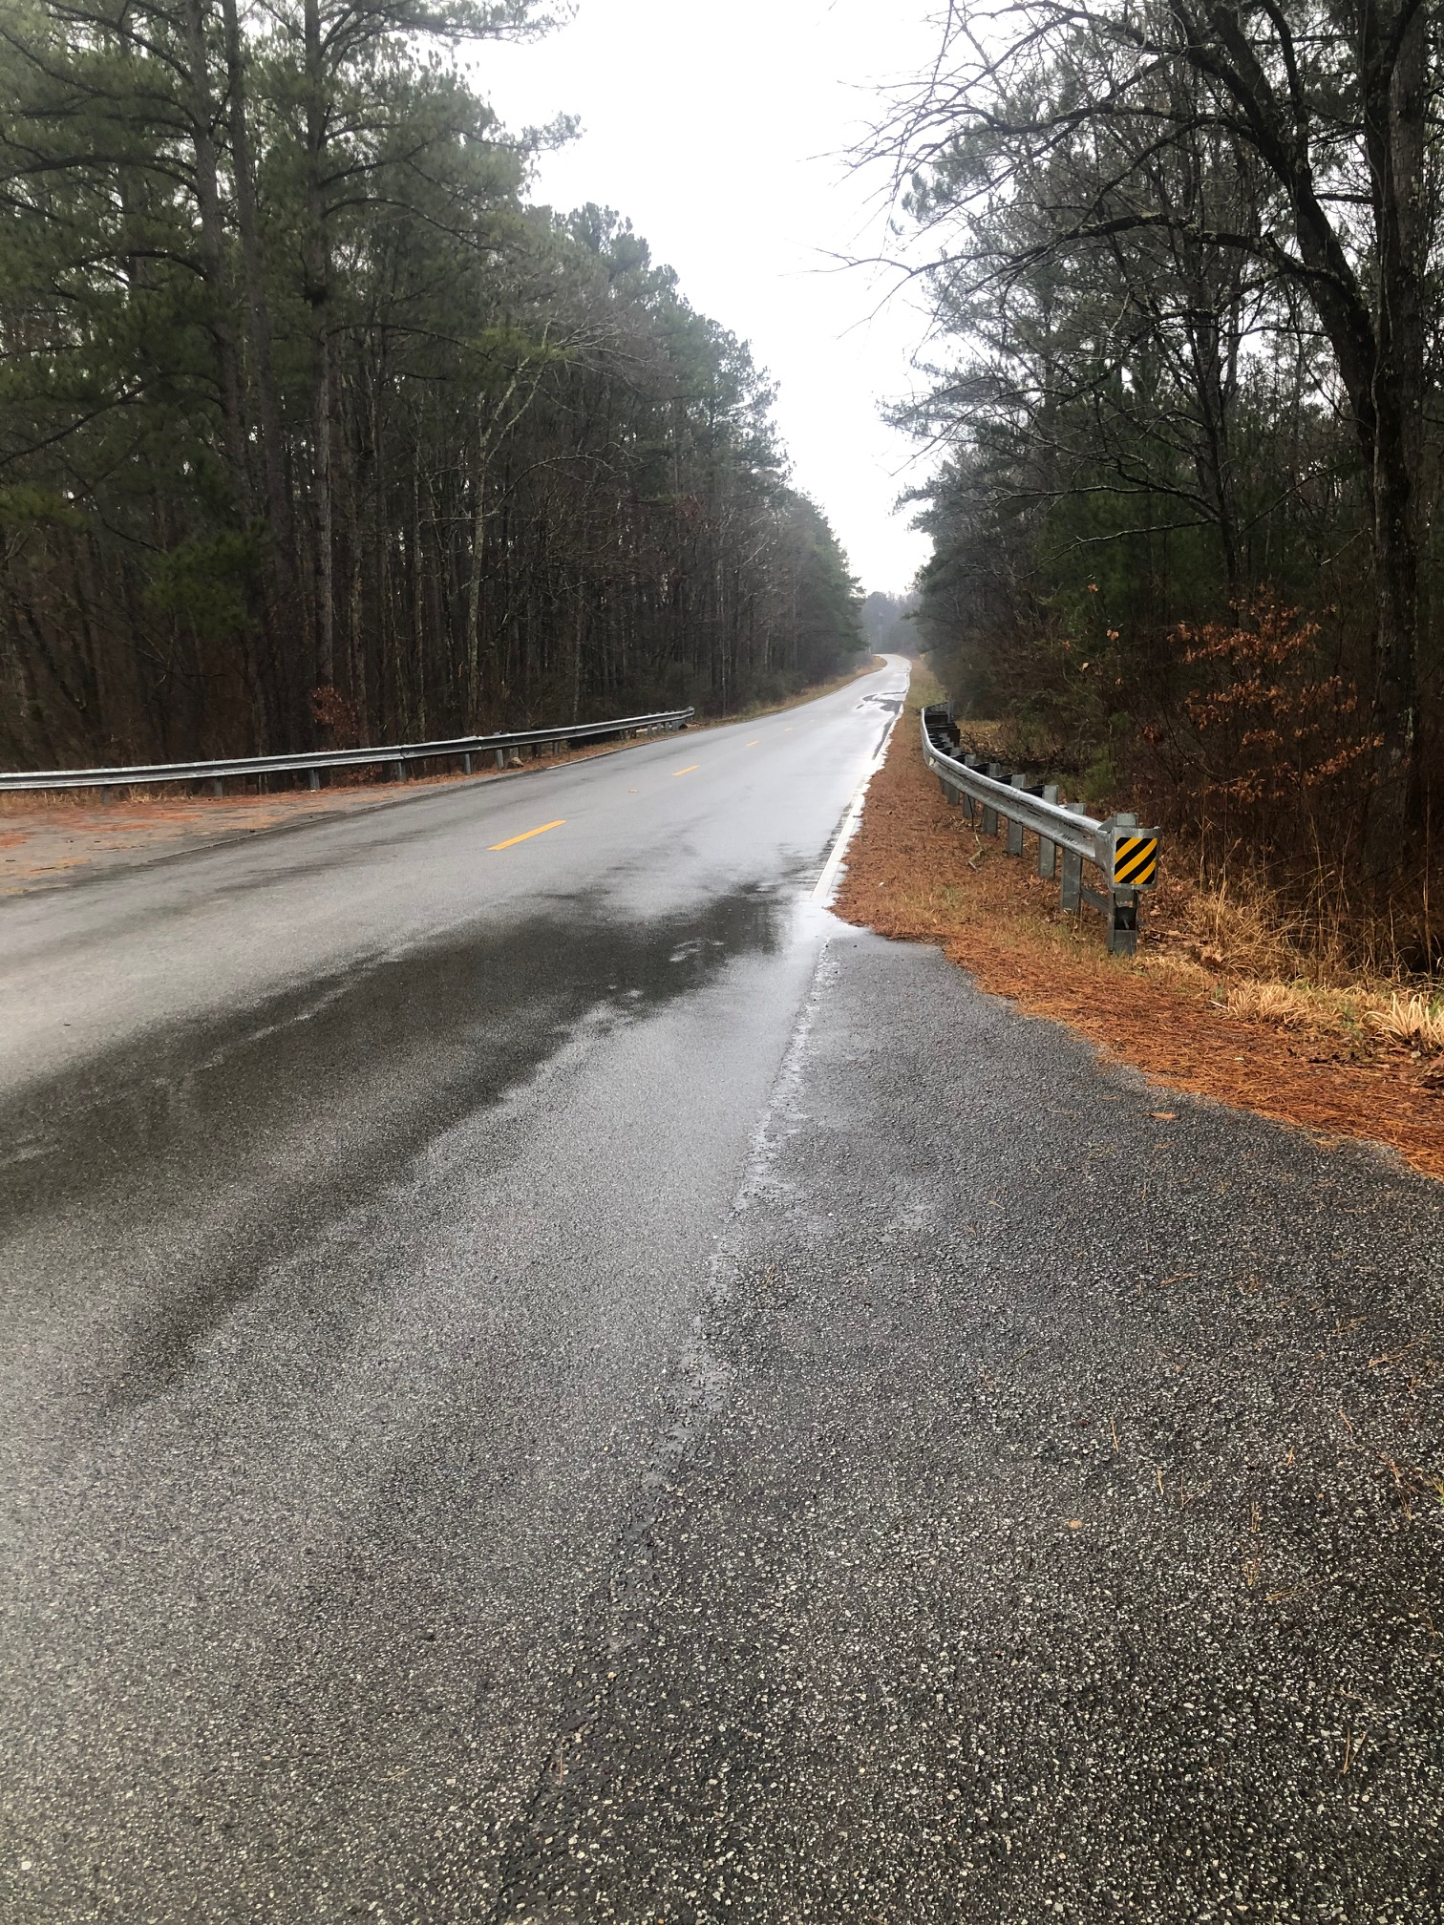
Rainy Day Work

Slide 9
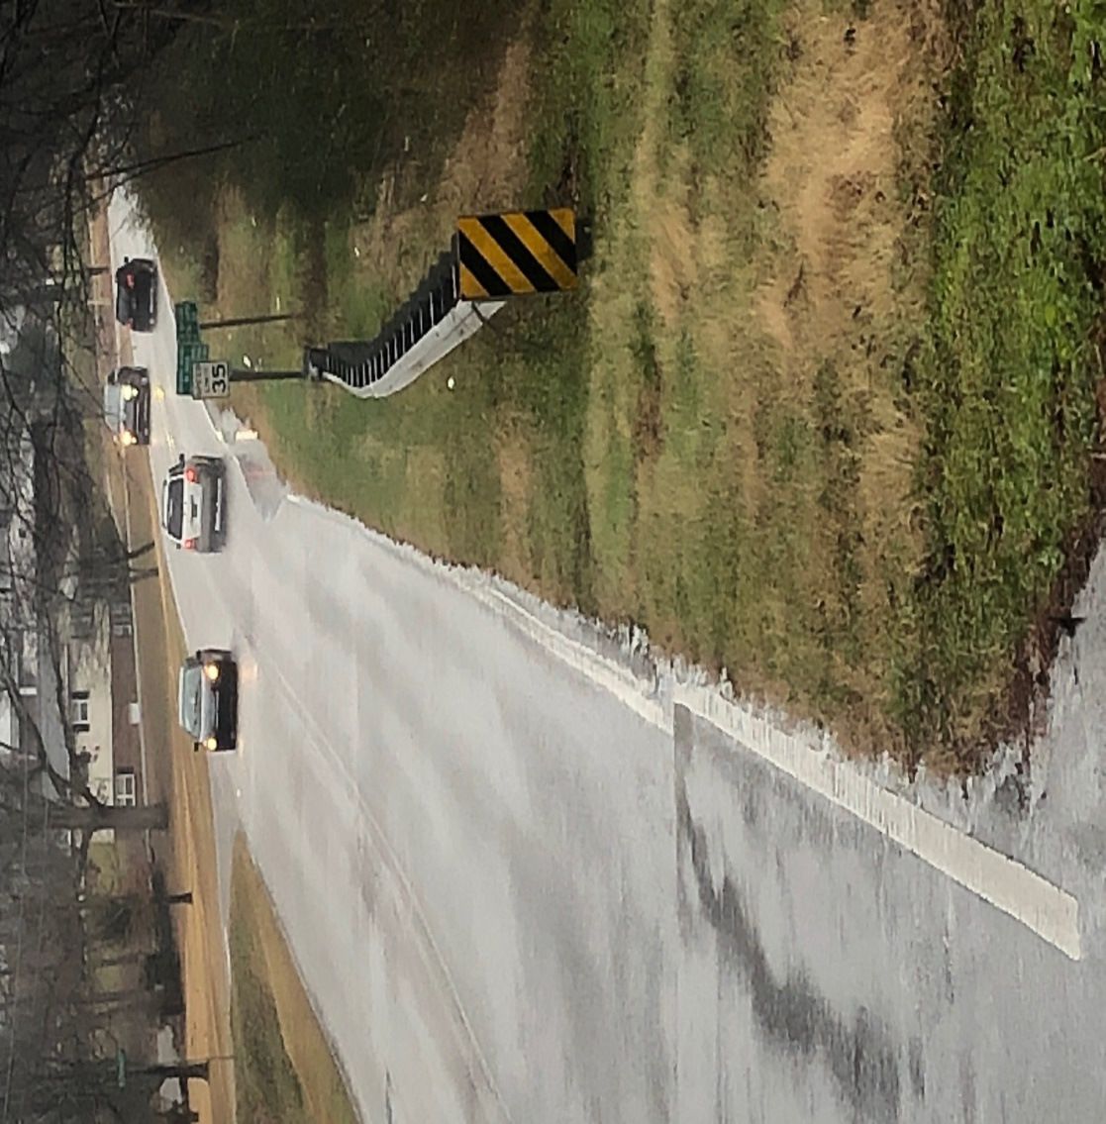
Rainy Day Work

Slide 10
Rainy Day Work
Scouting
Clogged Drainage Structures
Potential flooding can occur
Can be caused on or off of the Right of Way
Can require immediate action

Slide 11
Rainy Day Work

Slide 12
Rainy Day Work

Slide 13
Rainy Day Work
Scouting
Rutting- Can cause safety concern
Can be a sign of other issue

Slide 14
Rainy Day Work

Slide 15
Rainy Day Work
Scouting
Any standing water
On roadway or the shoulder primary concern for safety
Standing water can weaken subgrade leading to roadway failure

Slide 16
Rainy Day Work
Scouting
Potholes
Causes potential damage to vehicles
Can allow water to stand and penetrate subgrade

Slide 17
Rainy Day Work

Slide 18
Rainy Day Work
Bridge Maintenance
Clearing Vegetation
Helps eliminate hazards under bridge
Allows easier access for Bridge Inspection
Can help reduce risk of debris collection from high water flow

Slide 19
Rainy Day Work

Slide 20
Rainy Day Work

Slide 21
Rainy Day Work

Slide 22
Rainy Day Work

Slide 23
Rainy Day Work

Slide 24
Rainy Day Work
Bridge Maintenance
Cleaning Gutter Line of Bridges
Can impede the rain runoff on bridges
Can cause issues to the bridge deck

Slide 25
Rainy Day Work

Slide 26
Rainy Day Work

Slide 27
Rainy Day Work
Bridge Maintenance
Clearing abutment cap/bent cap of debris
Can cause deterioration of the bridge components lowering the life span

Slide 28
Rainy Day Work

Slide 29
Rainy Day Work

Slide 30
Rainy Day Work

Slide 31
Rainy Day Work
Housekeeping Items
Equipment Preventative Maintenance
Restocking supplies on Work Truck (i.e. Toilet Paper!)
Cleaning of Equipment
Service/Greasing of Equipment
All can reduce down time and protect the County’s investment

Slide 32
Rainy Day Work
Housekeeping Items
Inventory
Material stockpiles, haul if needed
Safety gear, first aid supplies, etc.
Materials for a particular project or work order

Slide 33
Rainy Day Work
Training
Work with new employees on training equipment operation
CDL learners permit practice driving
Additional Safety Toolbox Talk
Flagger training

Slide 34
Rainy Day Work
Summary and Key Points
To efficiently complete tasks while keeping employees safe and traveling public safe by performing tasks that are less affected by the weather.
Minimize lane closures during wet conditions
As a Supervisor, use good judgement to prioritize tasks!

Slide 35
Rainy Day Work
Summary and Key Points
Our Job is to maintain the County taxpayer’s investment in the Roadway system, safely, efficiently, and as timely as possible

Slide 36
`
Questions?

