Slide 1
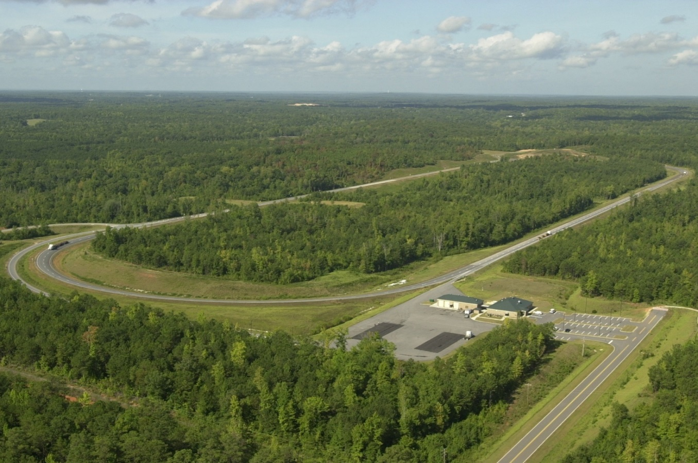
NCAT Pavement Test Track
Preservation Research Update

Slide 3
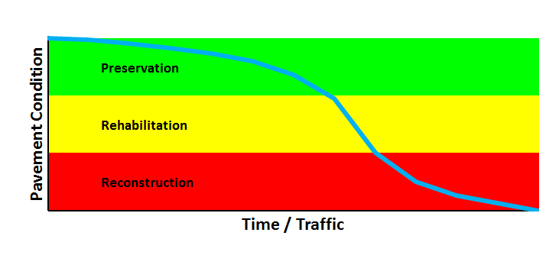
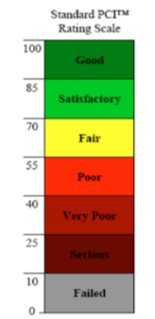
Background
Crack/fog seal
Chip/slurry/micro
Thin overlay
Thick overlay
Shallow mill/inlay or hot recycle + overlay
Deep mill/inlay or cold recycle + overlay(s)
Reclamation + overlay(s)
Select for
Lowest Life
Cycle Cost

Slide 4
Preservation Group (PG) Experiment
Need to quantify the benefits of preservation
Good materials, designs, placement quality
Designs verified with actual onsite materials
All rates calibrated before and verified as placed
MAP-21 (cracking, rutting, roughness) focus
Many other non MAP-21 performance measures
Benefits as function of pretreatment condition
Agency decision process implementation.

Slide 5
Preservation Options Studied
Emulsion surface treatments
Fog seals with, without rejuvenators
Chip seals with, without rejuvenators (scrubs), fibers
Micro surface with, without HiMA, fibers and double
Micro surface as Cape seals on chips, scrubs.
Plant produced thinlays
4.75 DGA (virgin, 50% RAP, 5% RAS, 11% RAP + 3% RAS)
DGA Thinlays over 100% RAP cold recycle (CCPR, CIR)
DGA Thinlays as “HMA Capes” on chips and scrubs
Open graded friction course (OGFC) surfaces (tack study)

Slide 6
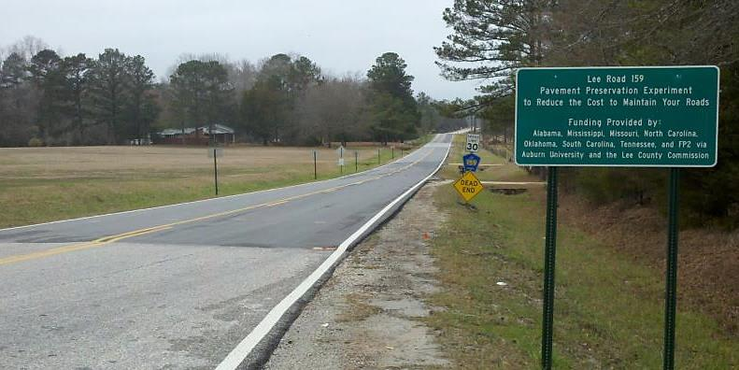
Lee Road 159 Low Traffic Preservation
70k ESALs
880k ESALs
Notes:
As of April 2016

Slide 7
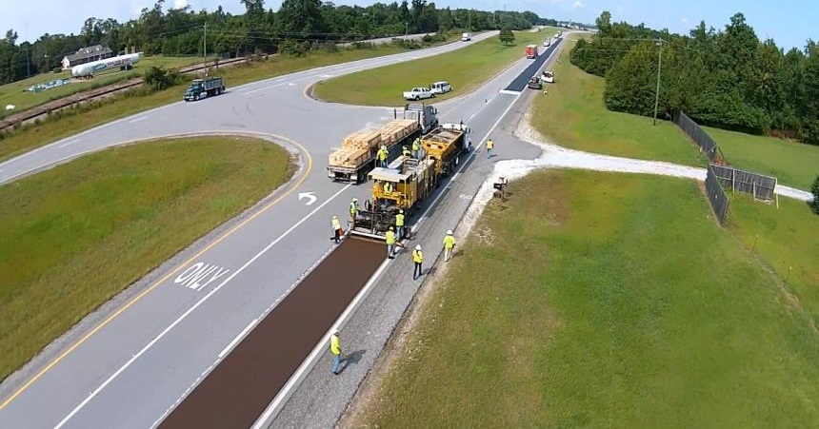
US-280 High Traffic Preservation
5.6M Vehicles, 1.6M ESALs
Notes:
As of April 2016

Slide 8
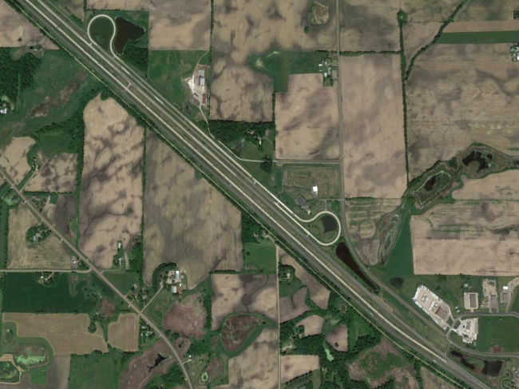
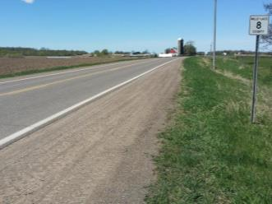
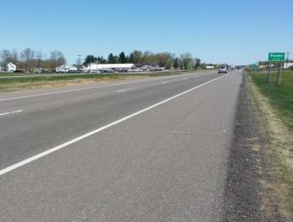
Cold Climate Sections

Slide 9
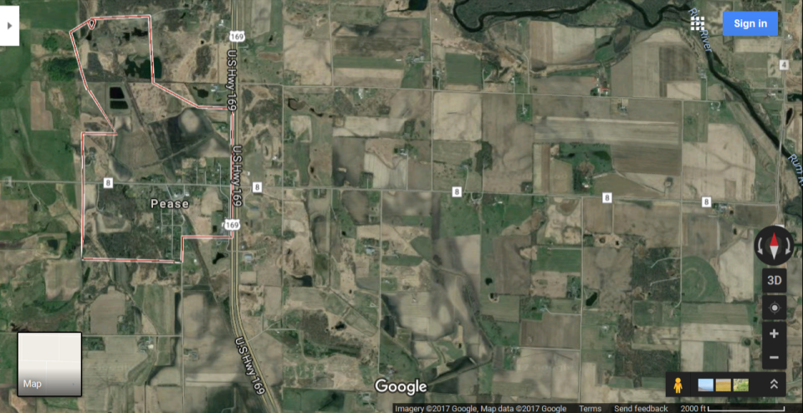
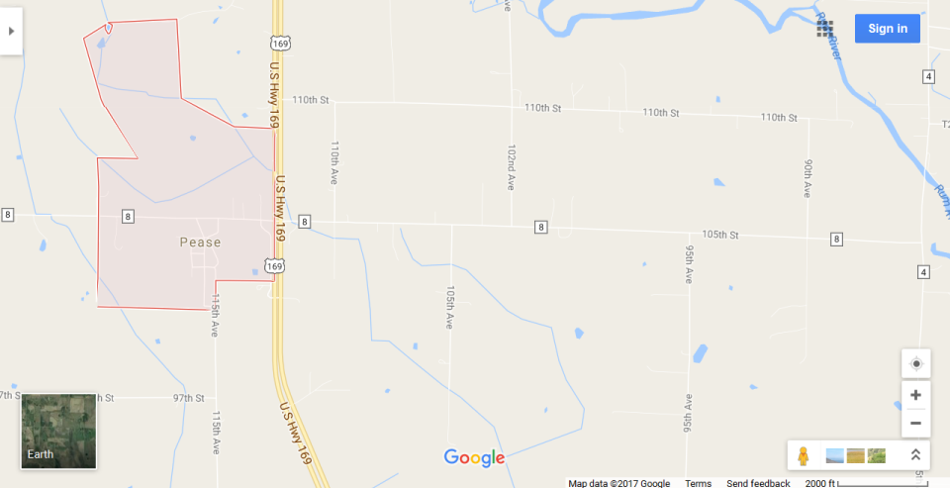
Cold Climate Sections
710 ADT with 8% Heavy Commercial
16,500 ADT with 3% Heavy Commercial

Slide 10
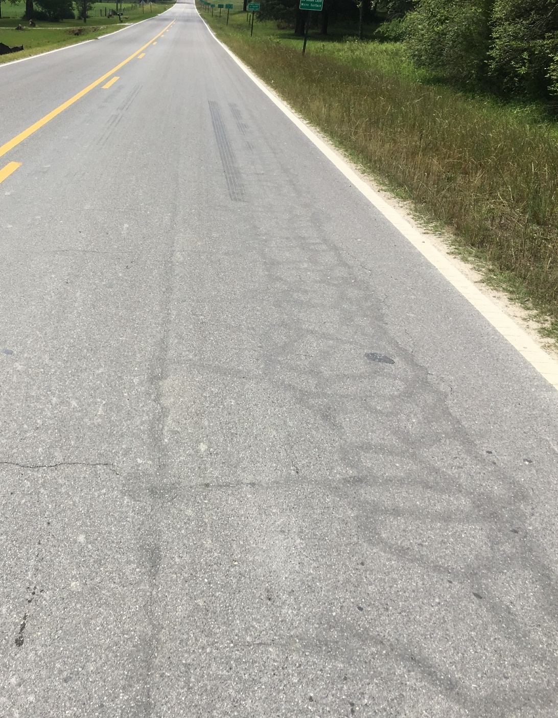
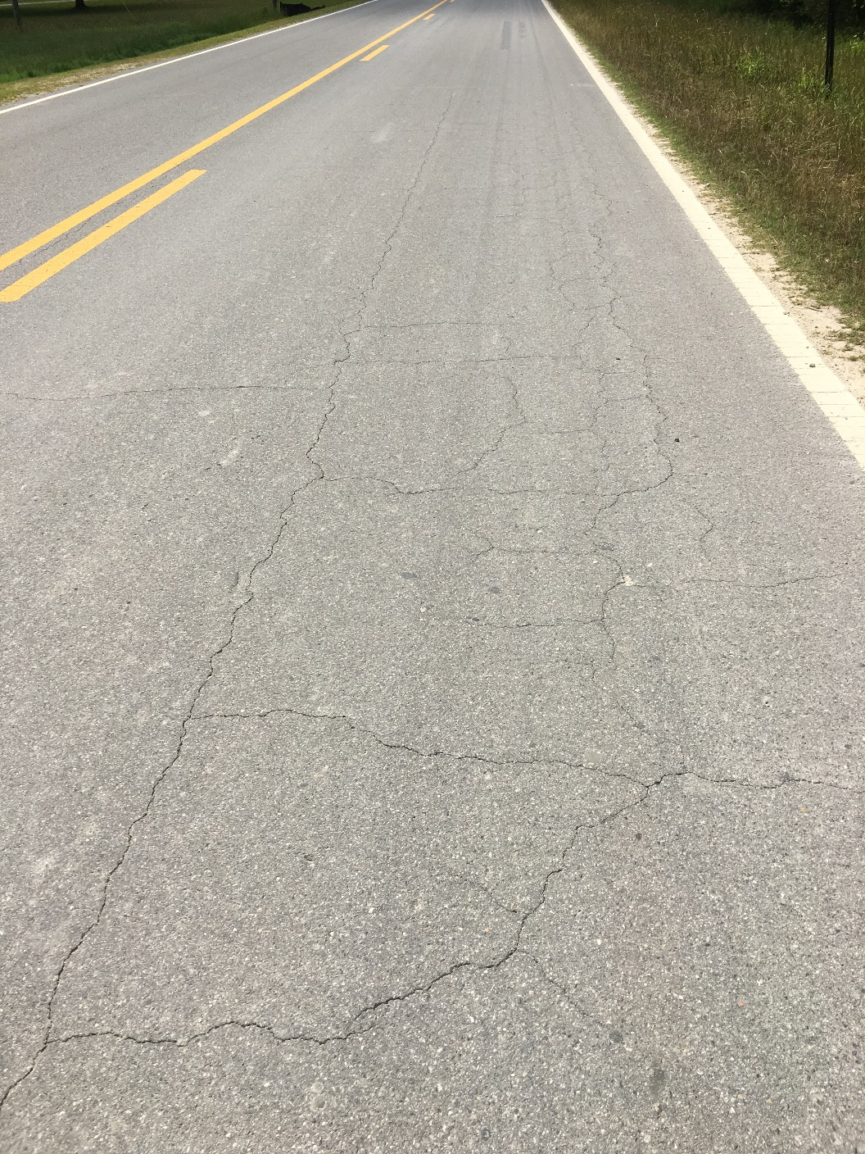
Similar Findings
SINGLE MICRO SURFACE
SINGLE MICRO SURFACE + CRACK SEALING

Slide 11
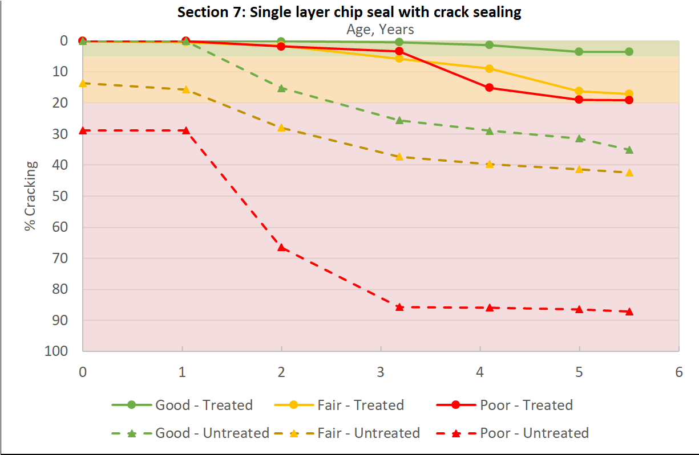
Benefits = f(Pretreatment Condition)
“Fair” Life Extending Benefit
“Fair”
Condition
Improving
Benefit at
End of
Year 5
MAP-21 Cracking
Green = “Good” (< 5%)
Yellow = “Fair” (5% ≤ 20%)
Red = “Poor” (> 20%)
Notes:
As of April 2016

Slide 12
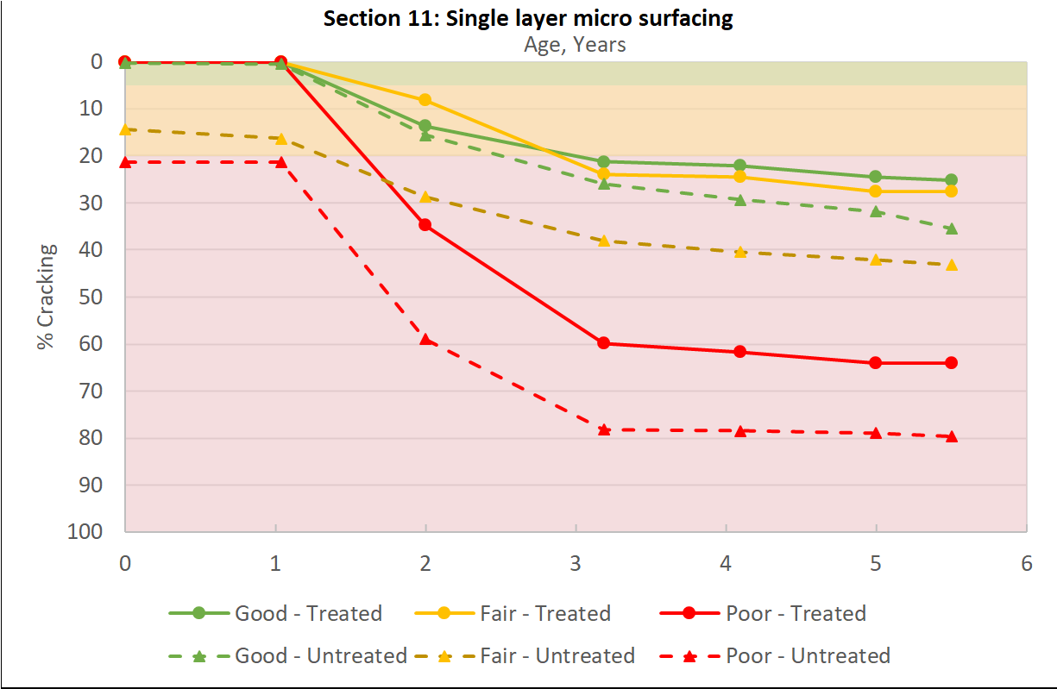
Benefits = f(Pretreatment Condition)
MAP-21 Cracking
Green = “Good” (< 5%)
Yellow = “Fair” (5% ≤ 20%)
Red = “Poor” (> 20%)
Notes:
As of April 2016

Slide 13
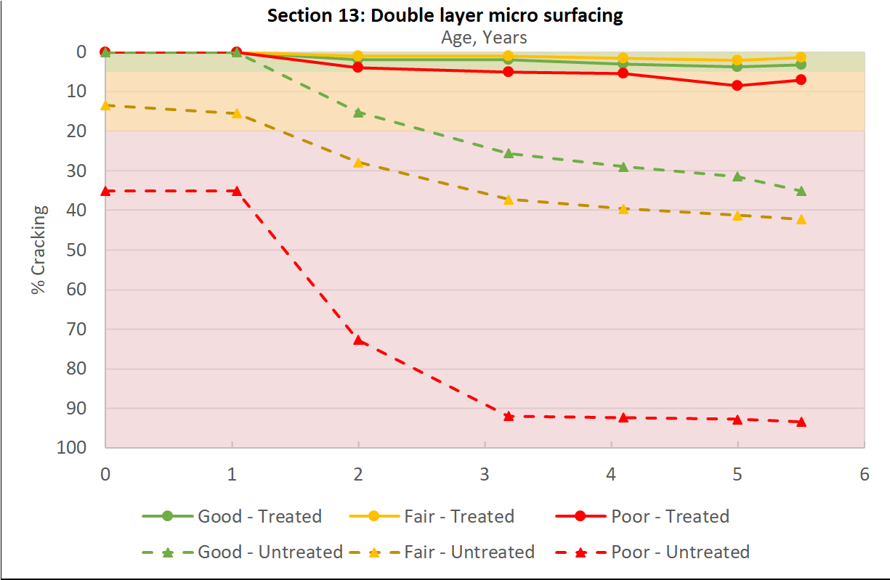
Benefits = f(Pretreatment Condition)
MAP-21 Cracking
Green = “Good” (< 5%)
Yellow = “Fair” (5% ≤ 20%)
Red = “Poor” (> 20%)
Notes:
As of April 2016

Slide 14
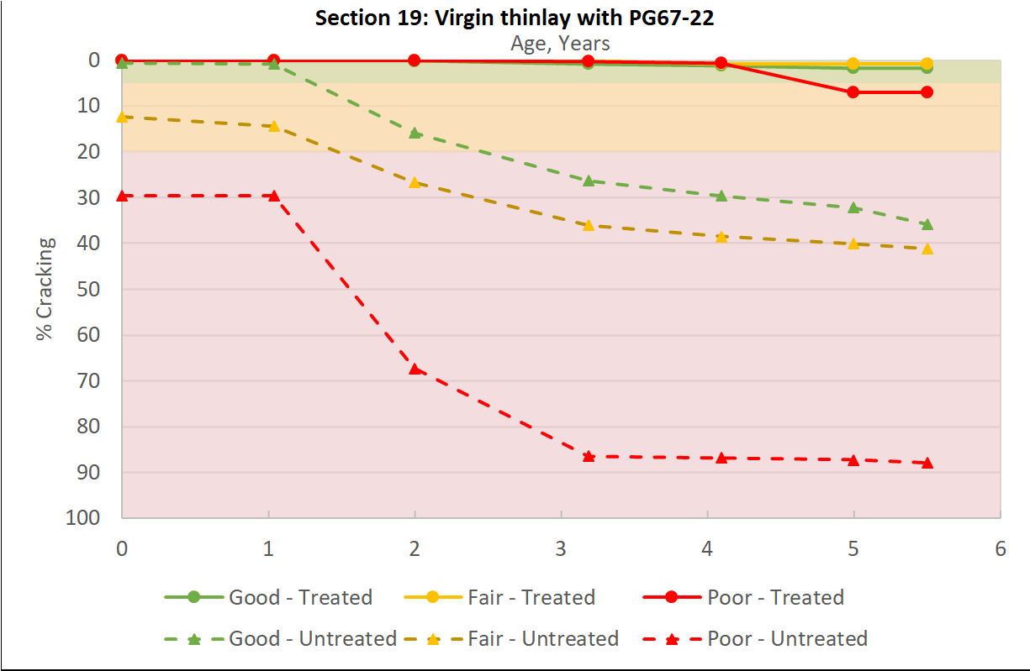
Benefits = f(Pretreatment Condition)
MAP-21 Cracking
Green = “Good” (< 5%)
Yellow = “Fair” (5% ≤ 20%)
Red = “Poor” (> 20%)
Notes:
As of April 2016

Slide 15
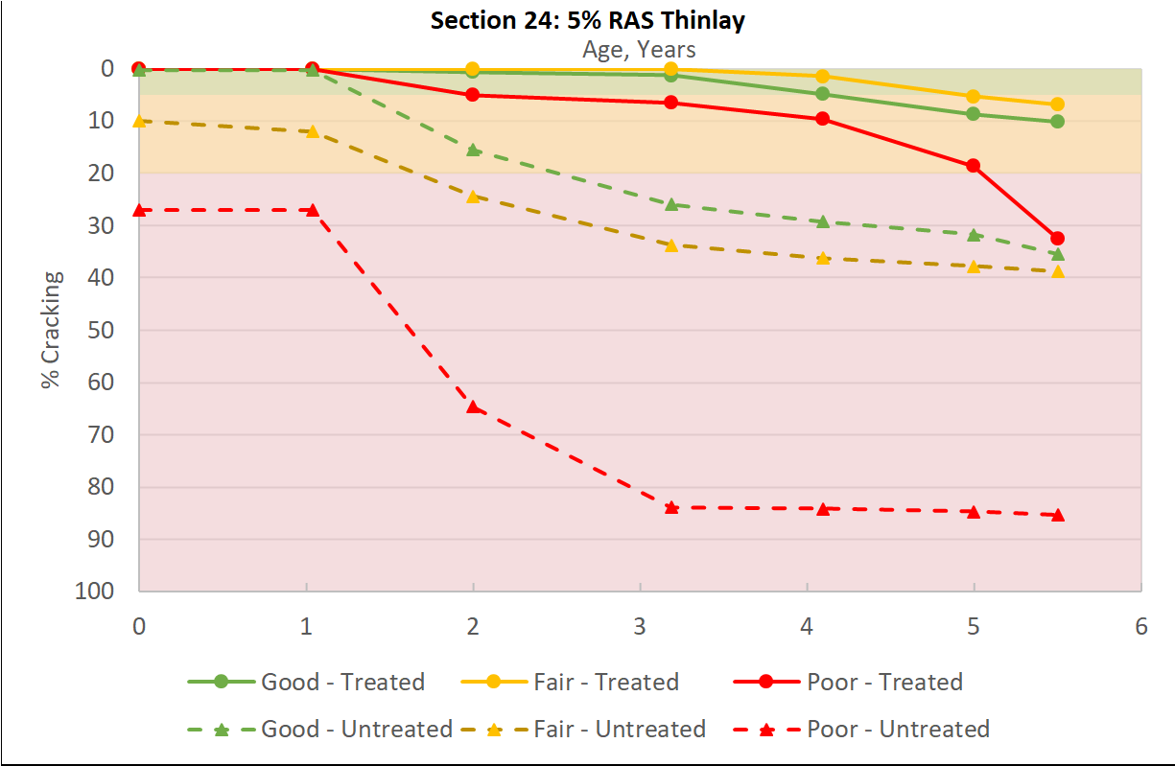
Benefits = f(Pretreatment Condition)
MAP-21 Cracking
Green = “Good” (< 5%)
Yellow = “Fair” (5% ≤ 20%)
Red = “Poor” (> 20%)
Notes:
As of April 2016

Slide 16
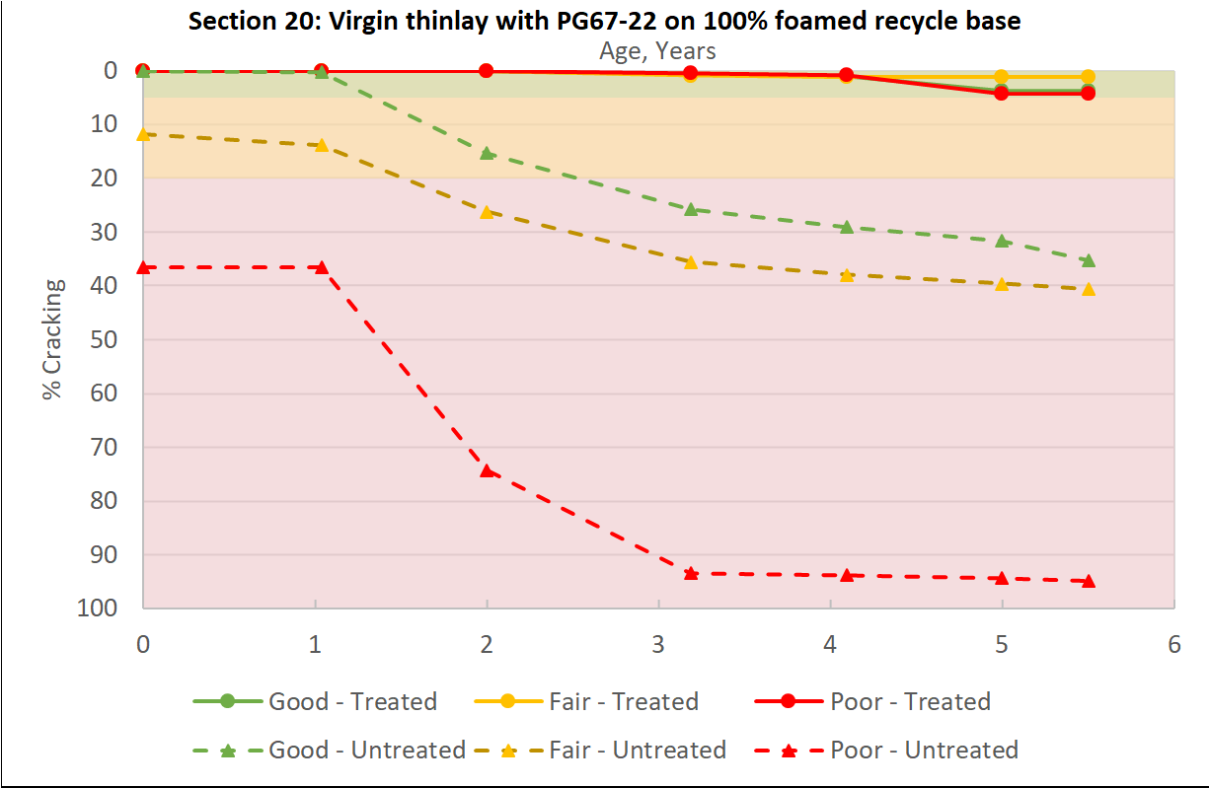
Benefits = f(Pretreatment Condition)
MAP-21 Cracking
Green = “Good” (< 5%)
Yellow = “Fair” (5% ≤ 20%)
Red = “Poor” (> 20%)
Notes:
As of April 2016

Slide 17
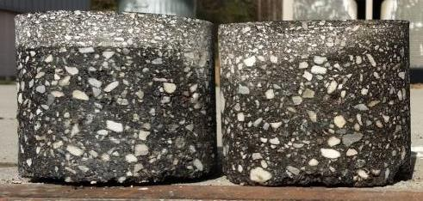
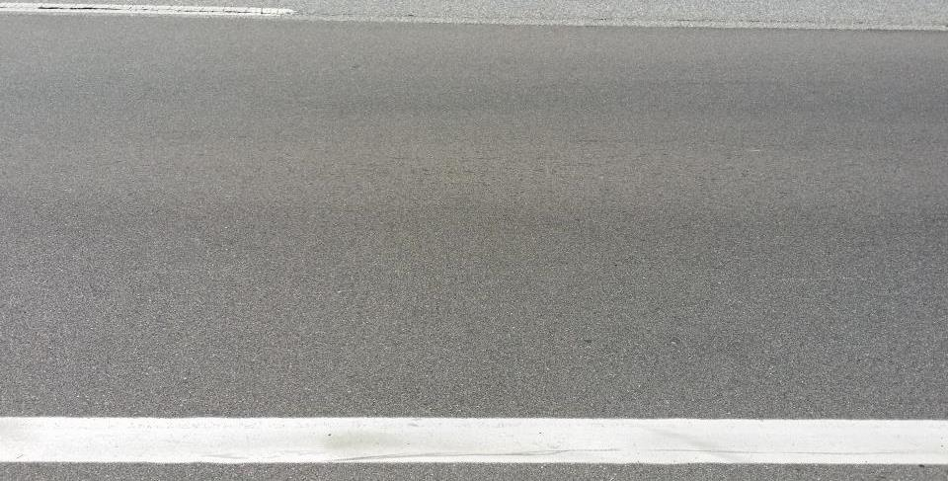
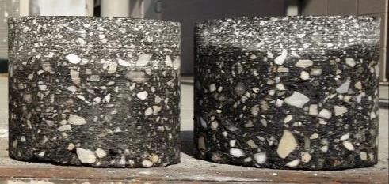
Benefits = f(Pretreatment Condition)
CCPR
No Rutting
Foam
Emulsion
No Cracking
CIR
Notes:
As of April 2016

Slide 18
Summary
Value of good materials, designs, construction, inspection
Life extending_{x} & condition improving_{y} preservation benefits
Measured reduction in subgrade moisture contents
Similar trends in south vs north, low vs high traffic sections
Planning underway for 2019 northern CR, FDR sections
Anticipate long term data collection for many years to come
Support for state agency decision process implementation
20 US state DOTs now supporting pooled fund, more likely.

Slide 19
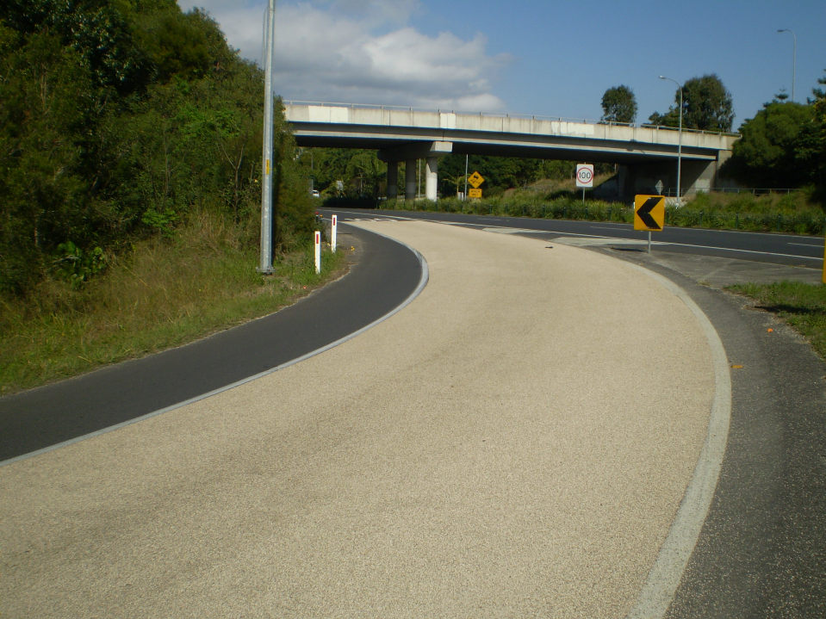
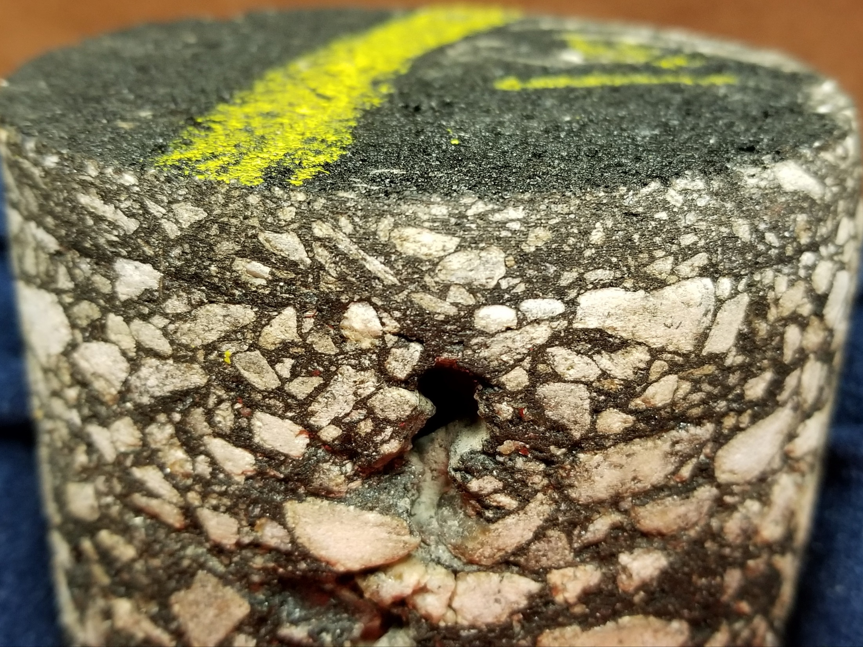
High Friction Surface Treatments
http://www.omnicrete.com.au/road-safety-surfacing/

Slide 20
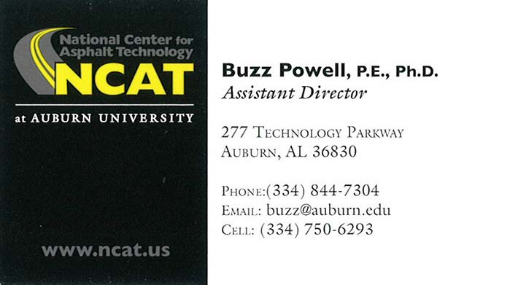
Dr. R. Buzz Powell, PE
Assistant Director
277 Technology Parkway
Auburn, AL 36830
Phone: (334) 844-6857
Cell: (334) 750-6293
Email: buzz@auburn.edu
Web: www.pavetrack.com
Twitter: www.twitter.com/pavetrack

