Slide 1
Maintaining a Safer Roadway
Case Study

Slide 2
Instructions
13 examples of safety issues that might be partially or fully addressed through some type of maintenance response follow
Work in groups of 3-4 or more and look at each photo and work together to answer 3 questions

Slide 3
Questions
What appears to be the safety issue(s)?
How might this situation impact safety and/or operations?
What actions might be taken to fix the issue?

Slide 4
Further Instructions
Note any assumptions you have to make in order to answer the questions
After about 5-10 minutes each we will discuss each example
If time allows we may discuss how we would prioritize which to address first

Slide 5
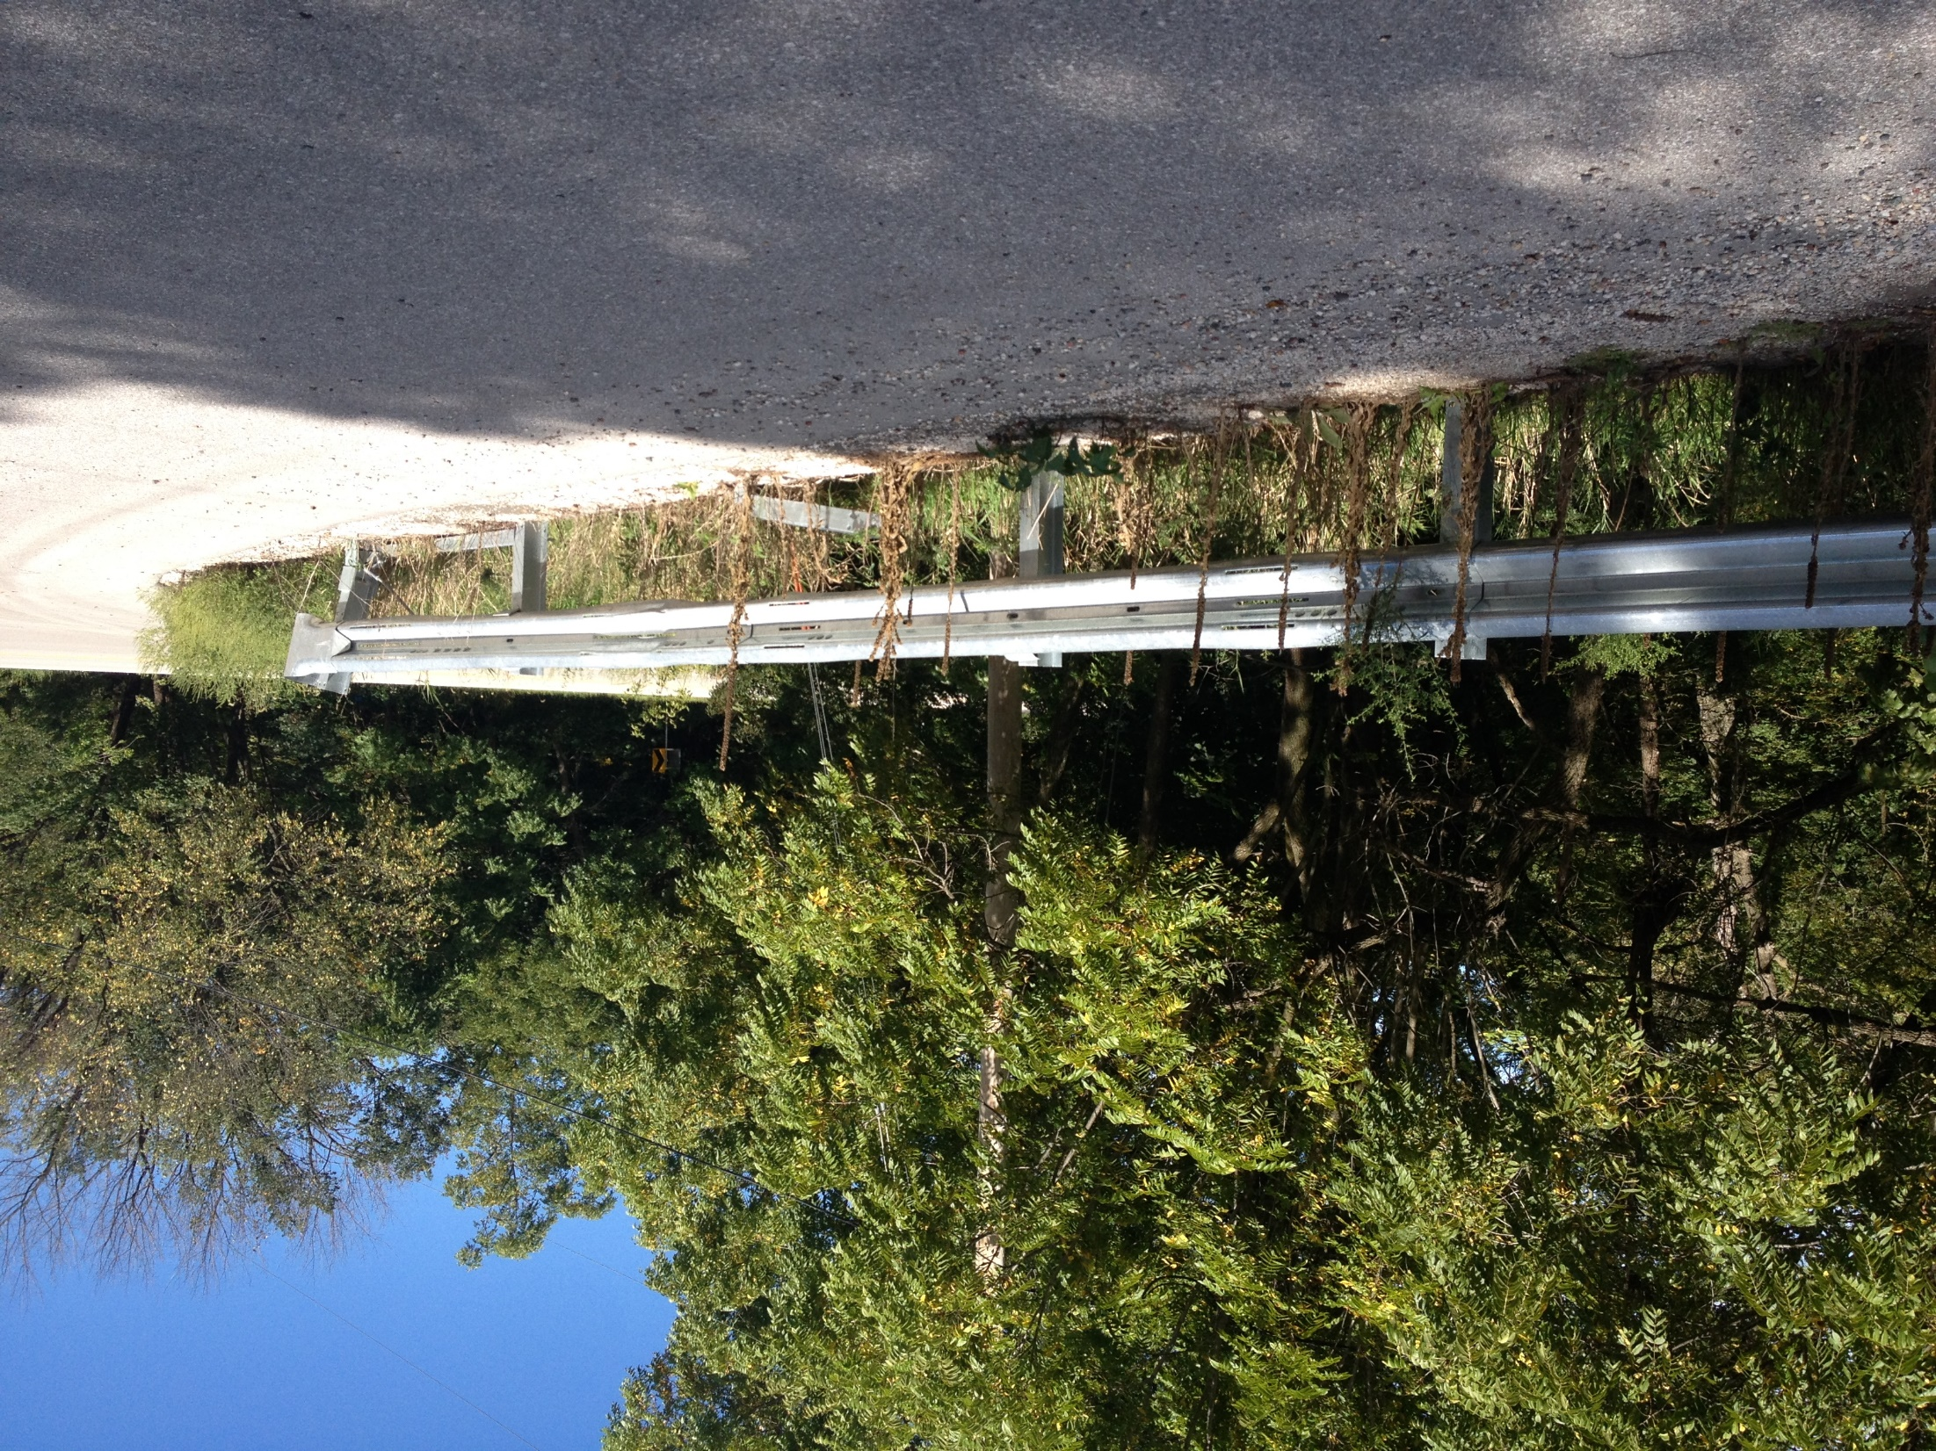

Example
Notes:
Guardrail has been hit, posts down.

Slide 6
Example 1
Rural Curve

Slide 7
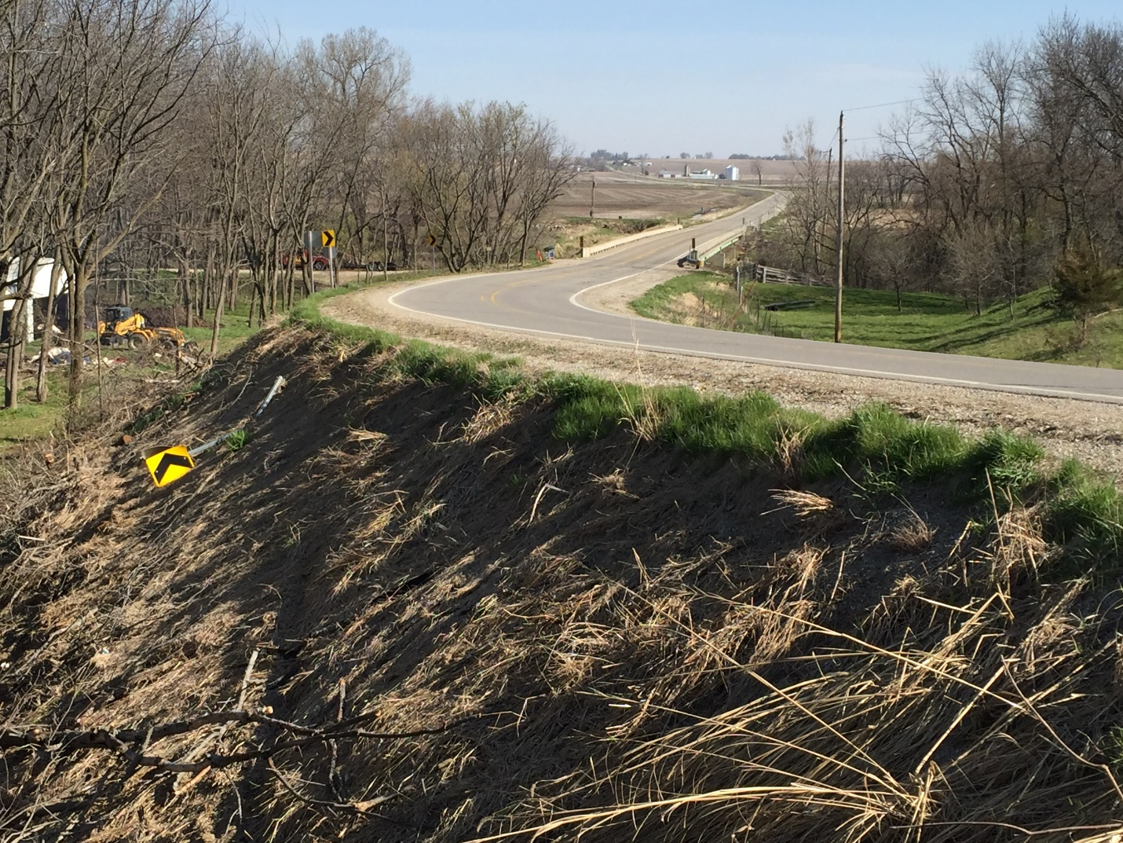
Notes:
Chevron has been knocked down.

Slide 8
Example 2
Intersection

Slide 9
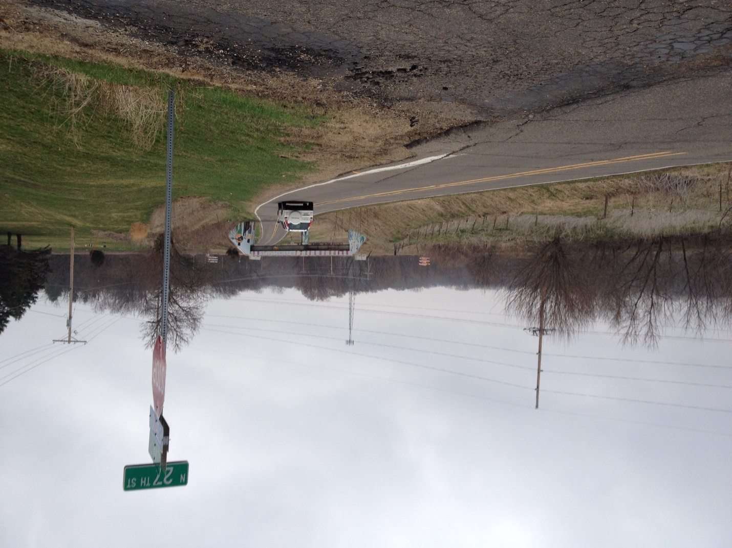
Notes:
Crumbling pavement/shoulder

Slide 10
Example 3
Bridge

Slide 11
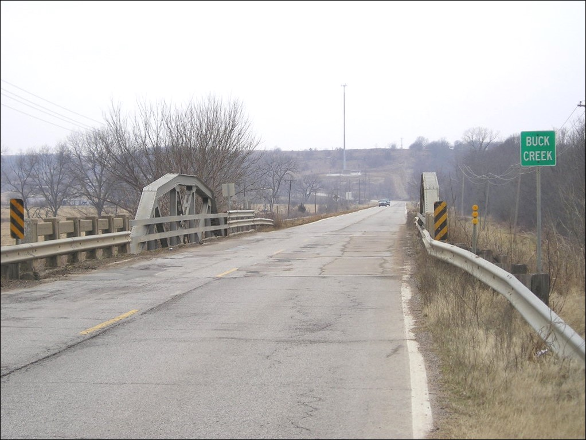
Notes:
Pavement markings covered, poor pavement

Slide 12
Example 4
Rural Curve 2

Slide 13
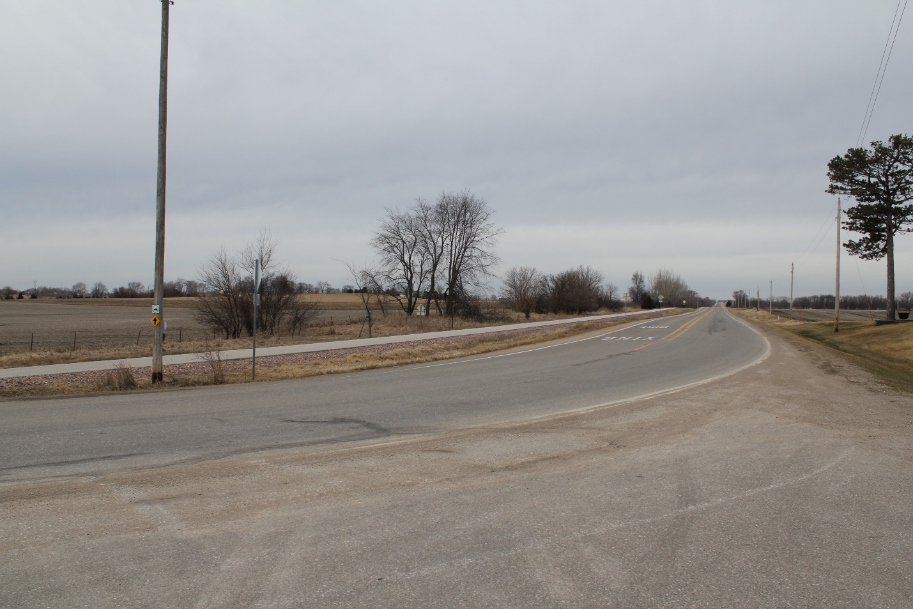
Notes:
Sand, access on curve, pavement marking, multi modal issues

Slide 14
Example 5
Rural Curve 3

Slide 15
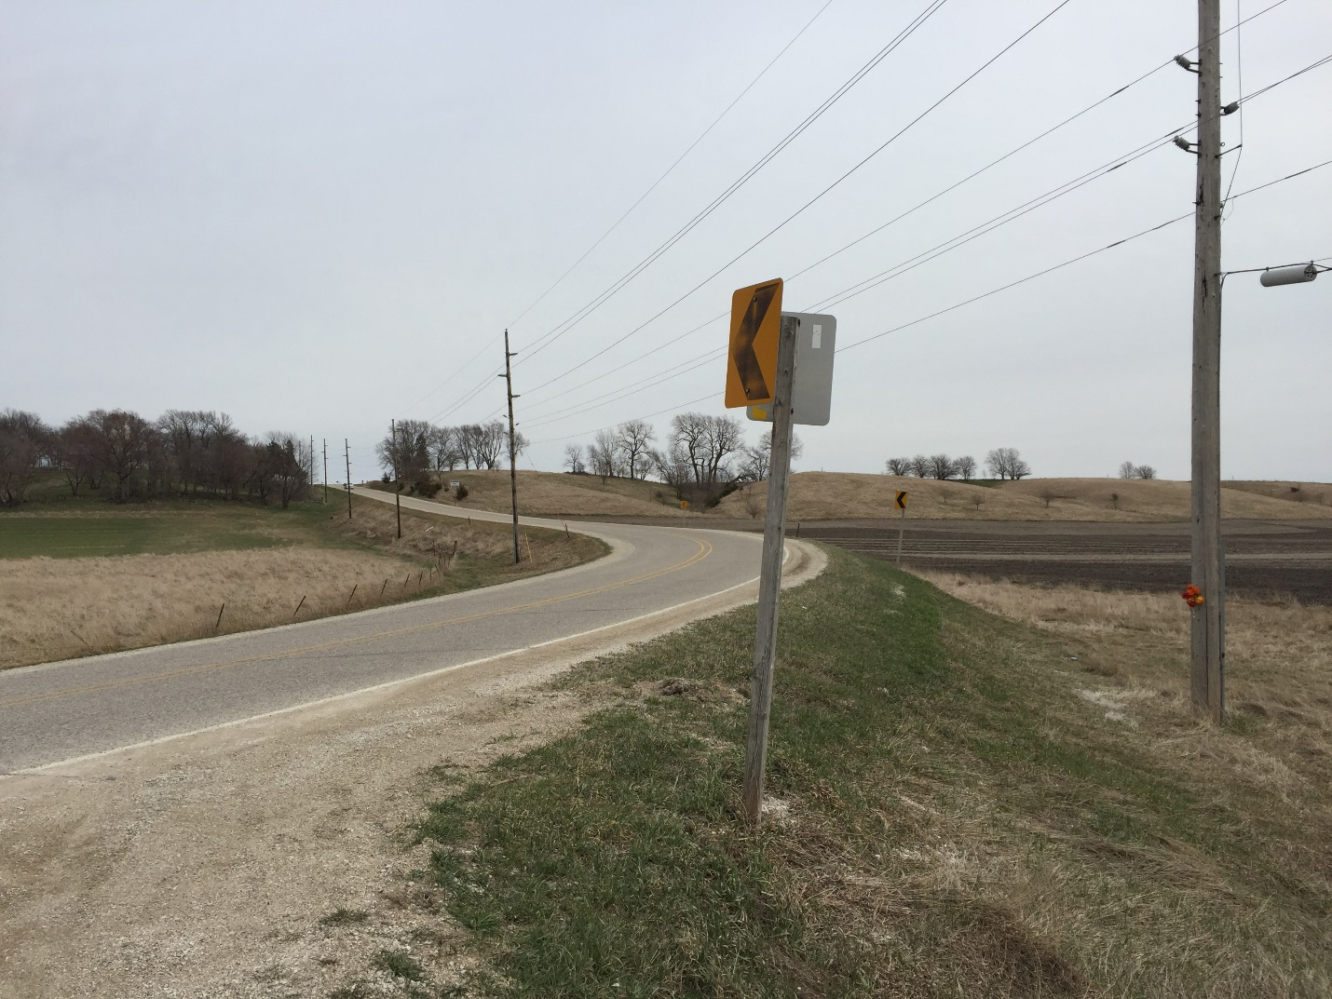
Notes:
Faded chevron, memorial on left, slopes?, aiming of chevron

Slide 16
Example 6
Rural Intersection

Slide 17
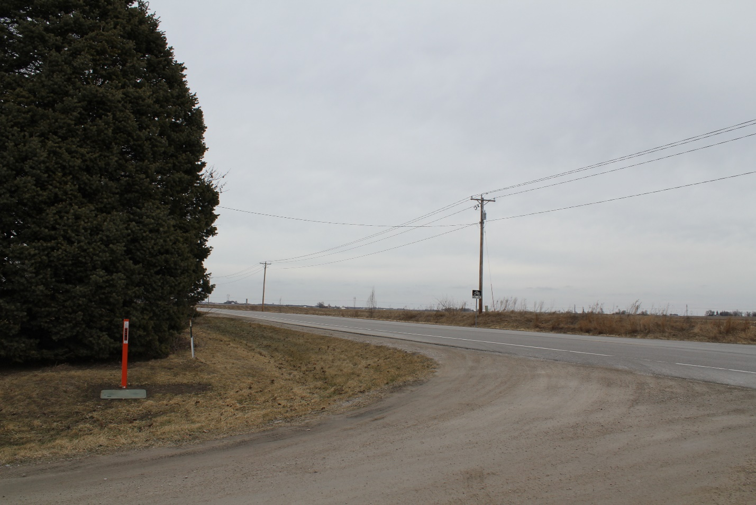
Notes:
Sight distance issue due to tree
Sight distance issue can make it harder to judge appropriate gaps
Trim or remove tree

Slide 18
Example 7
Rural Roadway

Slide 19
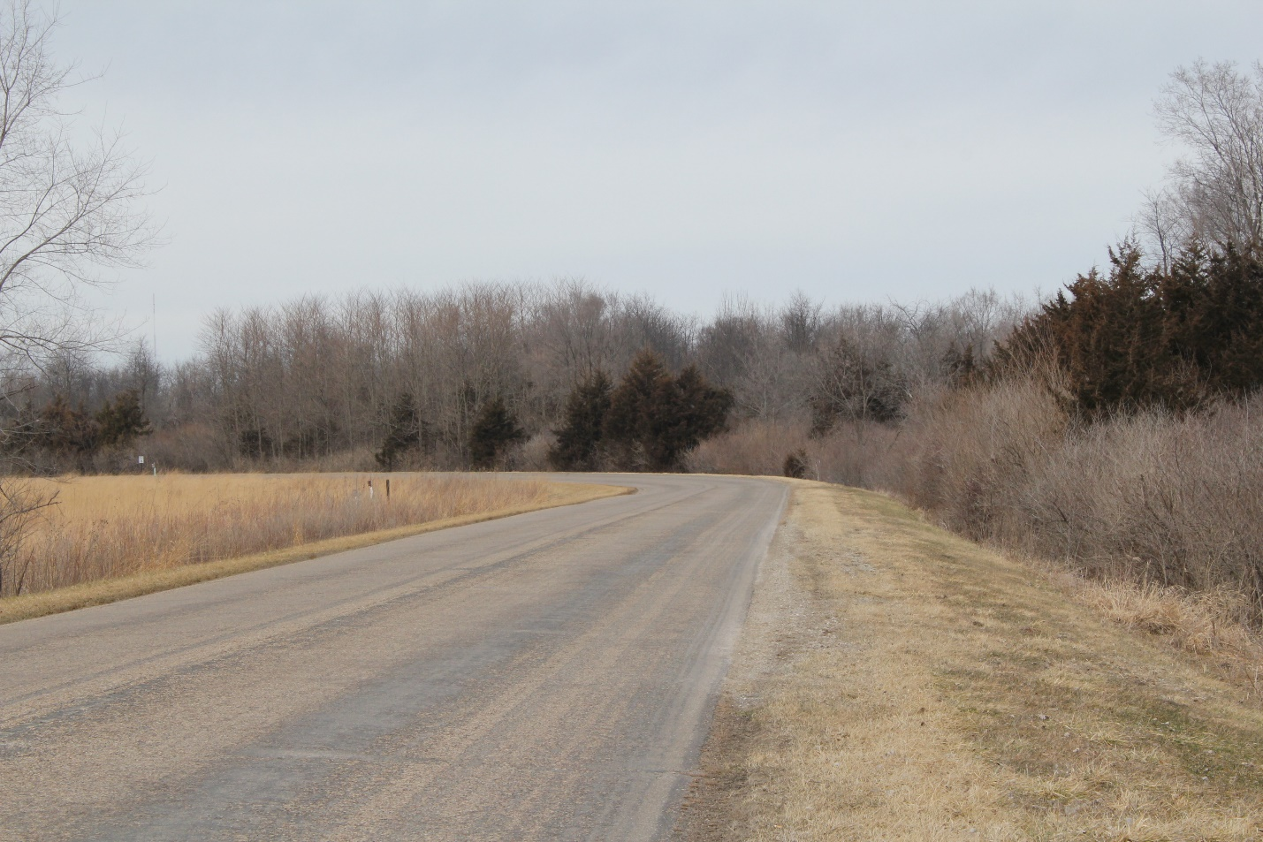
Notes:
Pavement markings are faded/gone no other delineation
Hard to recognize curve at night
Repaint or add delineation

Slide 20
Example 8
Roadside

Slide 21
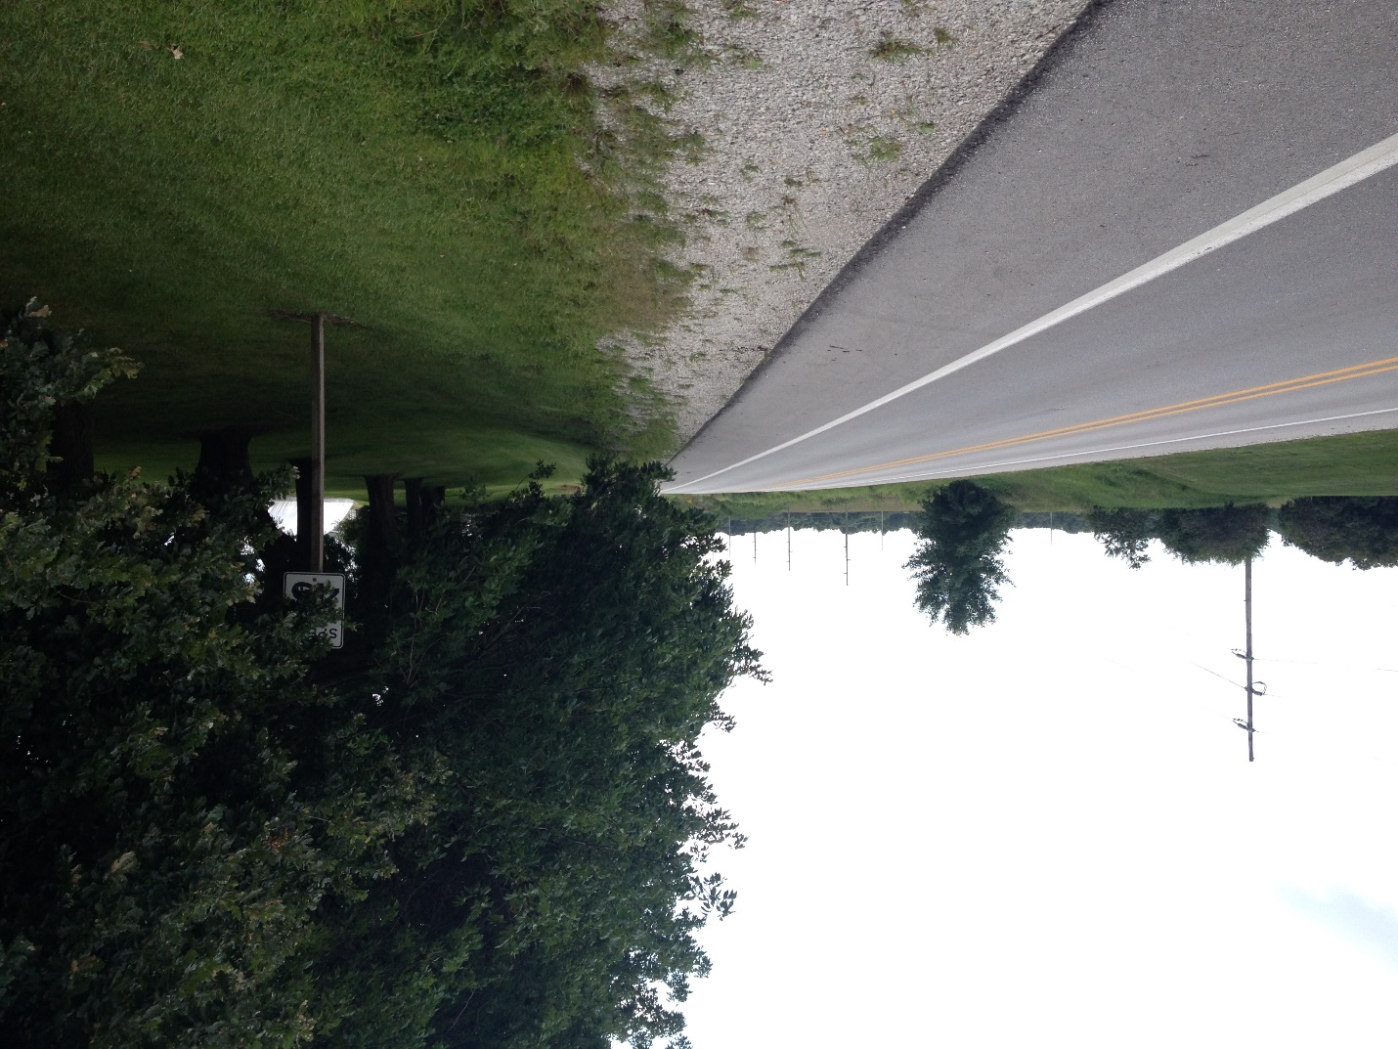
Notes:
Speed limit sign covered by tree
Driver not recognizing the change in speed limit
Trim branches

Slide 22
Example 9
Rural Curve and Shoulder

Slide 23
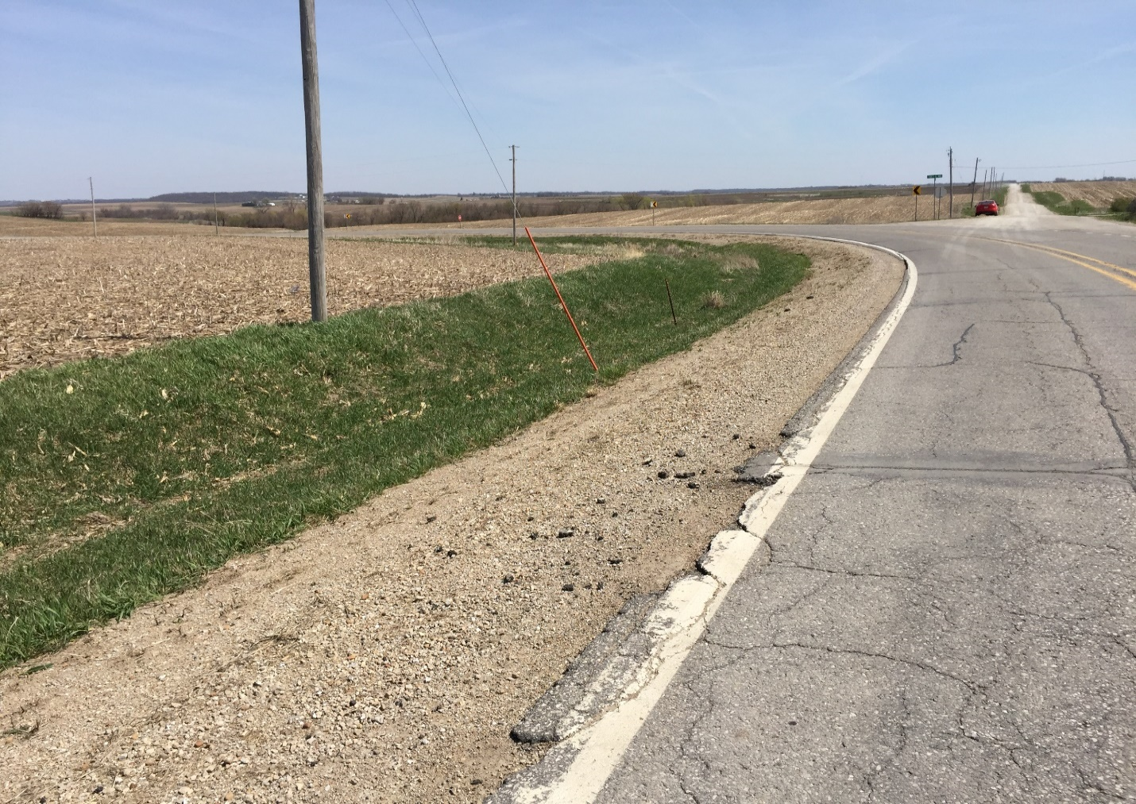
Notes:
Crumbling shoulder, cable in right of way and visual trap
Issues if drivers leave roadway
Fix through geometrics and other redesigns – breakaway cable

Slide 24
Example 10
Urban Signage

Slide 25
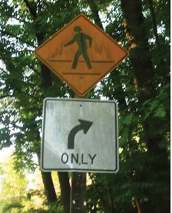
Notes:
Sign covered in dirt
Reduce retroreflectivity at night and make it hard for driver to see signs
Clean sign
Combination is inappropriate – should be on separate posts. Sign at top is also older – not in MUTCD any more. No crosswalk – diamond and arrow.

Slide 26
Example 11
Urban Intersection

Slide 27
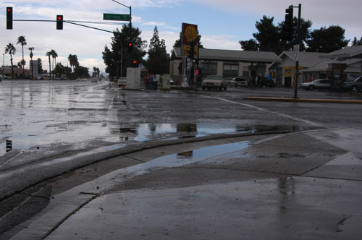
Notes:
Pooling water
Hydroplanning, pedestrians avoiding crosswalk

Slide 28
Example 12
Urban Shoulder

Slide 29
Notes:
Cable median barrier hit
Ineffective cable median barrier which could fail if hit again
Replace posts and retension cable

Slide 30
Example 13
Traffic Signal

Slide 31
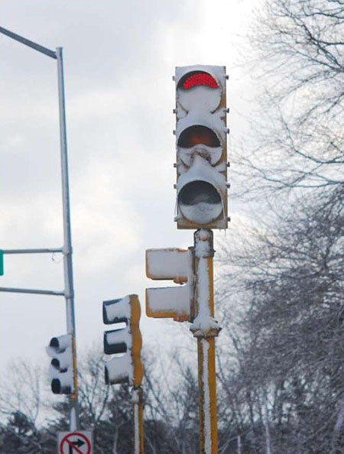
Notes:
Snow covering lights, due to LED
Make it so drivers cannot see signal
Clean snow or add a heater to light

